Slide 1
Webinar: MEANINGFUL ACCESS TO INFORMATION TO LEAVE NO ONE BEHIND
DA2I.IFLA.ORG #DA2I #Lib4Dev
#SDGs #GlobalGoals #Act4SDGs

Slide 2
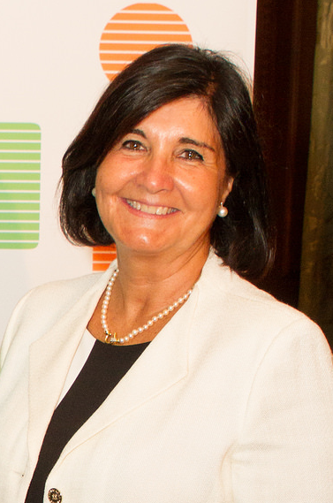
Glòria Pérez-Salmerón
IFLA President 2017-2019
Notes:
Welcome focused on the importance of a united library field
Set out (briefly) some of the other things we’re doing
Significance of the DA2I report as a tool for libraries

Slide 3
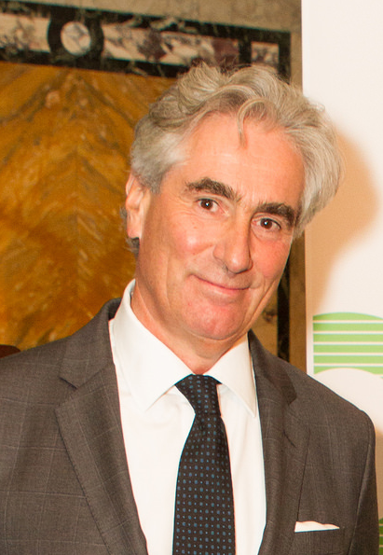
Gerald Leitner
IFLA Secretary General
Notes:
Welcome focused on the importance of a united library field
Set out (briefly) some of the other things we’re doing
Significance of the DA2I report as a tool for libraries

Slide 4
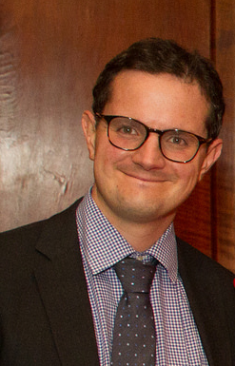
Stephen Wyber
Manager Policy & Advocacy
IFLA
Notes:
Welcome focused on the importance of a united library field
Set out (briefly) some of the other things we’re doing
Significance of the DA2I report as a tool for libraries

Slide 5
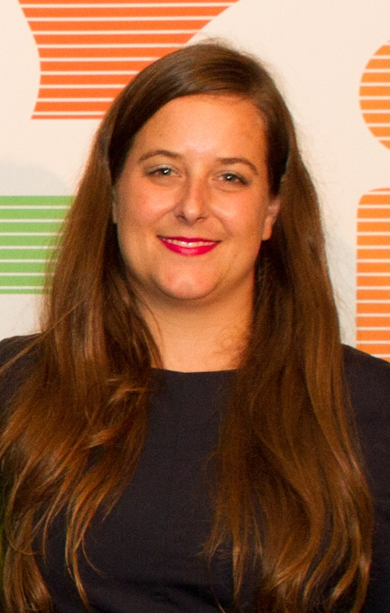
Maria Violeta Bertolini
Advocacy Communications Officer
IFLA

Slide 6
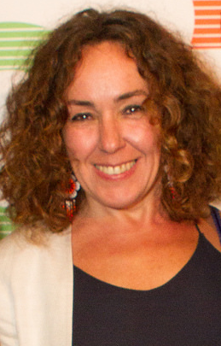
Maria Garrido
Principal Research Scientist
TASCHA

Slide 7
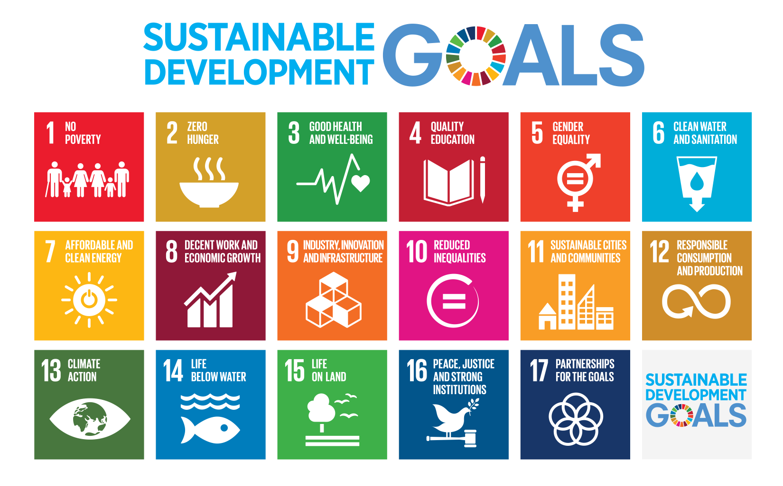
UNITED NATIONS 2030 AGENDA FOR SUSTAINABLE DEVELOPMENT
17 Goals
169 Targets
232 Indicators
Notes:
The United Nations 2030 Agenda was adopted two years ago, setting out 17 Goals, 169 targets and 232 indicators to monitor the progress towards 2030. It is important to highlight he interlinkages and integrated nature of the Sustainable Development Goals, this is of crucial importance in ensuring that the purpose of the new Agenda is realised. If we realize our ambitions across the full extent of the Agenda, the lives of all will be profoundly improved and our world will be transformed for the better.
Rather than simply promoting change in different policy areas, the UN 2030 Agenda underlines that there are interconnections and cross-overs. For example, improved gender equality in education will support economic growth, while more sustainable production will reduce the pollution that is harming agriculture.
Rather than simply setting out goals and then hoping that change will happen, the UN 2030 Agenda sets up a robust monitoring framework, with a set of 232 indicators, measuring progress against 169 targets. Every year, there is reporting against these, with many member states volunteering to report on how they are doing, at the UN’s High Level Political Forum.
Rather than talking only about what governments are doing, the UN 2030 Agenda promotes development as a right. The individual – all individuals – have a right to better lives, and more sustainable livelihoods. Development has to be delivered in a way that really means something for people and communities.

Slide 8
AFFIRMATION
Notes:
In addition to this innovative, more holistic approach, there is something else special about the 2030 Agenda. Following intensive engagement by IFLA and partner organisations, the final result, agreed in 2015, represents a real affirmation of the role of libraries.
It does this in a number of ways, which we will discuss, but most importantly, it underlines that access to information is essential for development.
When people are able to find, understand, and use information, they can take better decisions about their own lives, and the lives of those around them. They can connect with others, near and far, and build new communities and networks. They can create and innovate, producing new ideas and knowledge.
This is exactly what libraries are there to do.

Slide 9
16.10: Ensure public access to information and protect fundamental freedoms, in accordance with national legislation and international agreements
Notes:
The reference to access to information comes under SDG16, which focuses on essential, cross-cutting drivers of development, alongside peace and justice. By including it, all of the UN’s 196 Member States, and so yours included, made this core objective of libraries their own.
In including access to information, governments accepted the key argument of the Lyon Declaration, with which many of you may be familiar. This is an advocacy document that was used to positively influence the content of the UN 2030 Agenda. It was drafted by IFLA and a number of strategic partners in the library and development communities in 2014, and it was signed by 604 organisations from all over the world.
The Declaration states clearly that access to information supports development by empowering people to:
Exercise their civil, political, economic, social and cultural rights
Learn and apply new skills
Make decisions and participate in an active and engaged civil society
Create community-based solutions to development challenges
Ensure accountability, transparency, good governance, and empowerment
Measure progress on public and private commitments on sustainable development.
In doing so, it underlined that we needed to understand ‘access to information’ broadly. This access had to be meaningful – people had to be able not only to find and read, but also understand, use and share the information necessary to promote sustainable development and democratic societies.
But this is not the only reference in the SDGs to the core missions of libraries.

Slide 10
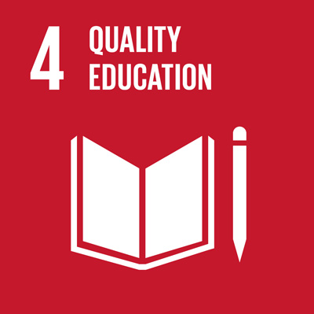
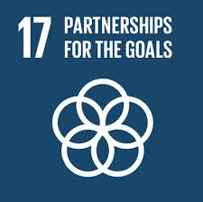
4.6: By 2030, ensure that all youth and a substantial proportion of adults, both men and women, achieve literacy and numeracy
9C: Significantly increase access to information and communications technology and strive to provide universal and affordable access to the Internet in least developed countries by 2020
11.4: Strengthen efforts to protect and safeguard the world’s cultural and natural heritage
17.8: Fully operationalize the technology bank and science, technology and innovation capacity-building mechanism for least developed countries by 2017 and enhance the use of enabling technology, in particular information and communications technology
Notes:
A further four areas of library strength are featured in the SDGs:
There is an ambitious target for youth literacy under SDG 4. Libraries have a major role to play here, especially when local education systems are underfunded and underperforming, or where young people need additional support. We know from OECD figures that reading outside of school is associated with up to a year’s advance in literacy skills over those children who do not read.
There is SDG 9, which highlights both innovation and Internet access. Here too, libraries have a key role in providing safe and free access, with the support necessary to help those who may be uncomfortable online to get the best out of the web. 7M adults a year in Europe go online for the first time in libraries.
SDG 11 focuses on cultural heritage as a means of building sustainable cities and communities, calling on governments to invest in effective safeguarding activities. As IFLA has underlined, libraries have a core role in both preserving our past, and in making it accessible to communities.
SDG 17, which covers many enabling factors of development, underlines the need to enhance the uses of ICTs. IFLA’s statement on digital literacy, released during WLIC, not only stresses the importance of this goal, but also sets out many examples of how libraries are delivering this.

Slide 11
OPPORTUNITY
Notes:
Of course these are only a few of the ways in which library objectives and activities align with those set out by governments two years ago.
This alignment is important, as it means that the SDGs are not only an affirmation of what libraries are doing, but an opportunity. They give us the structure, and the language, to make the case for well supported libraries as partners for development.
Many of you will be involved in the International Advocacy Programme, which is working to build the capacity of the library field to make its voice heard in decision-making processes. You are doing amazing things to make the case locally, and nationally, for libraries.

Slide 12
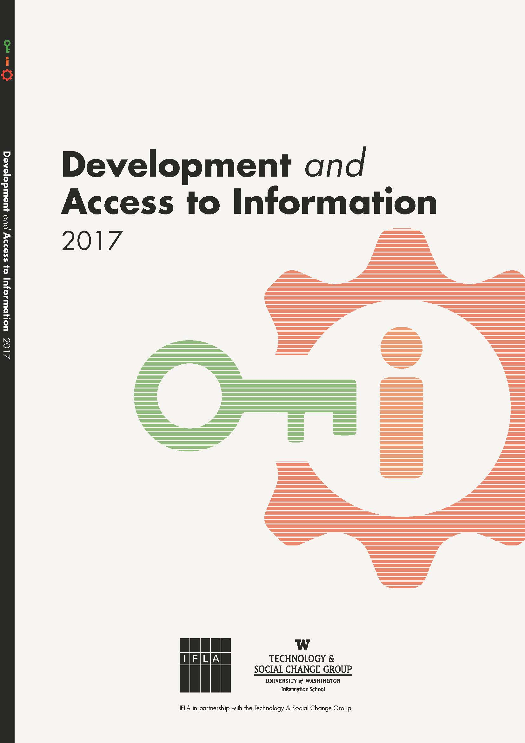
DA2I REPORT
Partnership with TASCHA
Annual report, closely linked to the UN’s 2030 Agenda
Delivery on a commitment in the Lyon Declaration
First report launched on 17 July 2017 in New York
Notes:
At the global level, IFLA has worked in partnership with the Technology & Social Change Group at the University of Washington Information School (TASCHA) to produce the Development and Access to Information Report.
This will be published annually, around the time of the High Level Political Forum of the United Nations, the key event each year for monitoring progress towards the SDGs. It delivers on a specific commitment made in the Lyon Declaration.
The first edition was launched on 17 July 2017 in New York.
It brings together statistical analysis of the key factors underpinning meaningful access to information, provides evidence of the impact of access to information on different aspects of development, and discusses the particular contribution that libraries can make. As time passes, it will be possible to track the steps countries are making towards delivering access to information this as part of the United Nations 2030 Agenda.

Slide 13
THE DA2I MESSAGE
Access to information is essential for development, but to make a difference, it needs to be meaningful.
In areas such as health, agriculture, and innovation, access can empower individuals and communities.
There can, however be economic, legal, social and technical barriers to this.
Libraries have a unique potential to overcome these, through their facilities, staff, and status in the community.
They need to be supported accordingly.
Notes:
As for the message the DA2I report is looking to send, the key is in the title – there can be no sustainable development without access to information.
The title deliberately does not refer to libraries, partly because it is ‘access to information’ that appears in the SDGs, partly because this can be a more effective way of convincing politicians to act. While some may naturally warm to libraries, others care more about agricultural extension services, public health information, smarter decision-making in government, skills and training, smart cities, and individual autonomy.
Yet these are all services that libraries help provide. By focusing first on the challenges, and things that will interest politicians, it is then possible to get them focused on libraries as a key delivery partner.
In other words, the report establishes the problem – inadequate access to information means lost productivity, poor decisions, ill-health and inequality, and so failure to meet the SDGs – and then offers a solution – libraries. These have a unique potential to overcome challenges given their expertise, trusted nature, and strong knowledge of the needs of their communities. As long as they have the right support from their governments.

Slide 14
DA2I PROJECT OBJECTIVES
Demonstrate how access to information contributes to development
Demonstrate libraries’ contributions to providing equitable access to information
Raise the visibility of libraries in development
Serve as a tool to advocate and to generate conversations around the contributions of libraries to development
Notes:
To do this, the report provides a solid research base designed to draw the attention of UN member states, intergovernmental organizations, funders, civil society groups and other stakeholders working in development including influential NGOs, and the library community itself, to the invaluable contribution information access makes to development across the board.
In order to accomplish this, this report:
Establishes a baseline of access to information indicators to track progress over the lifespan of the SDGs Agenda (2015-2030).
Highlights how libraries are well placed to support achievement of all of the the SDGs through access to information, raising the visibility of sector with external partners, and making it easier to form partnerships at a national level. It stresses the particular role of our institutions for minority groups.
Examines the different ways in which access to information and libraries are contributing to advancing the SDGs, focusing specifically on the priority areas identified by the High Level Political Forum each year.

Slide 15
ACCESS TO INFORMATION (A2I)
The rights and capacity to use, create, and share information in ways that are meaningful to each individual, community, or organisation.
Notes:
It is important to remember that, as set out in the Lyon Declaration, access is more than just finding or reading a book. For the Development and Access to Information (DA2I) project, access to information is defined as:
The rights and capacity to use, create, and share information in ways that are meaningful to each individual, community, or organisation.
While the value of information access has been demonstrated in many settings, the adoption of the UN SDGs and the corresponding UN 2030 Agenda provides an opportune moment to consider the broader relationship between information and development.

Slide 16
DA2I FRAMEWORK
Information and communications access infrastructure
Social context of use
Capabilities
Legal and policy landscape
Notes:
The ability of information access to contribute to sustainable development is influenced by a combination of structural factors (e.g., policies and physical infrastructure) and human/social factors (e.g., usage, population characteristics, and skills). Therefore, the DA2I proposes a framework to describe four interdependent dimensions that influence access to information and its ability to advance the SDGs:
Information and communications access infrastructure: the connectivity (and material resources) that establishes the physical connection to information.
Social context of use: the variety of local, cultural factors that shape the way users will engage with information.
Capabilities: the body of functional knowledge, skills, and resources a population develops over time that shapes the nature of how information is used or not used.
Legal and policy landscape: the policies and regulatory frameworks that promote or hinder connectivity, affordability, inclusiveness, and rights. (E.g., spectrum management, universal access funds, copyrights, freedom of speech, privacy, and security.)
The DA2I framework is substantially informed by Burnett & Jaeger’s (2005) Information Life Worlds, combined with elements from UNESCO’s Media and Information Literacy Assessment Framework. The DA2I framework also reflects a general consensus among practitioners, researchers, and informed policymakers that access to technology alone is not enough to build inclusive and participatory societies.

Slide 17
DA2I BASELINE: 17 INDICATORS
Notes:
The research process consisted of analysis to support development of the indicator baseline; stakeholder consultations; data analysis strategy (curation, processing, and analysis); and country classification. Table 1.1 provides a list of the indicators selected for the baseline.
Indicator baseline: Starting from a research phase reviewing 36 international organizations that research and monitor development-related indicators, such as the International Telecommunication Union (ITU), World Bank, and UN Development Programme. The resulting collection of 300 potential indicators was then culled according to several criteria, including geographical coverage, how recently and frequently data has been collected, relevance, and availability.
Stakeholder consultations with representatives from IFLA, TASCHA, UNESCO Institute for Statistics, and NGOs to define the project’s approach to baseline indicator selection and data analysis.
Data analysis strategy. After selecting indicators, we amassed and processed a large body of data associated with the indicators. The variety of data sources, data types, and data collection strategies introduced comparison challenges.
For classification, global data is presented by region (applying the regional groupings used in the UN SDG report), or by income group (applying World Bank income group classifications). Country-level data is presented when the indicator was collected only in some countries, so regional grouping would not be representative of the group. Finally, the labels “developing country” and “developed country” are used as in the UN SDG report, and sometimes use other characterizations as “less developed,” “more developed,” etc.
17 indicators will be monitored in the next 13 years. Baseline can be expanded with data about libraries, such as the one that is being gathered by the Library Map of the World.

Slide 18
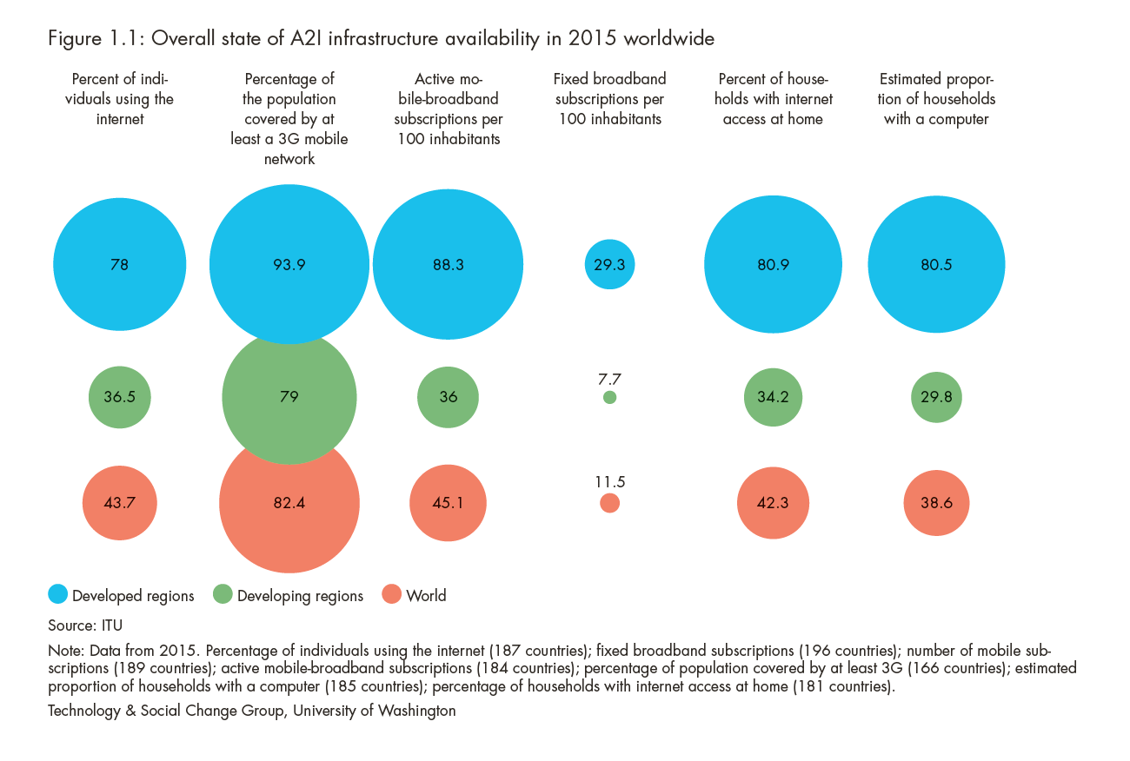
A2I INFRASTRUCTURE: THE STATE IN 2015
By 2016, almost 45 percent of the world’s population used the internet and 80 percent of people lived in areas covered with a 3G network or better.
Affordability of mobile services and devices a challenge. In Sub-Saharan Africa, mobile broadband costs almost 13 percent of monthly GNI per capita
Notes:
The first dimension of access to information is physical infrastructure: the reach and robustness of information and communication technologies. Such infrastructure is critical to achieving a more equitable distribution of knowledge and resources, while also providing a platform for sustainable economic growth.
The DA2I analysis uses two sets of indicators of technical infrastructure: mobile indicators and fixed, landline indicators. Each technical platform encourages certain types of use and discourages others. It’s worth recognizing that globally people are increasingly using the internet to address their information needs.
As shown in Figure 1.1, from 2010 to 2015 nearly 1.3 billion people came online, a majority via mobile devices.
By 2016, almost 45 percent of the world’s population used the internet and 80 percent of people lived in areas covered with a 3G network or better. This is a significant point – over half of the people who today are not online do have the infrastructure necessary to connect, but don’t, or can’t.
Despite the network coverage, far fewer mobile broadband subscriptions were active in less-developed countries (36 per 100 inhabitants) than in more-developed countries (88 per 100 inhabitants). Internet access at home also grew from 14 percent to 34 percent in the same period.
Affordability of mobile services and devices a challenge. In Sub-Saharan Africa, mobile broadband costs almost 13 percent of monthly gross national income (GNI) per capita.

Slide 19
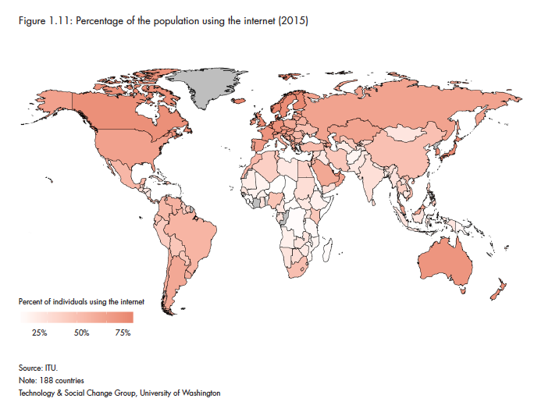
A2I CAPABILITIES: WHO IS USING IT AND FOR WHAT PURPOSES
People in less-developed countries are using social networking sites more actively than people in developed ones.
People in less-developed countries use the internet for online courses more actively than people in more-developed countries.
Only 39 percent of people in less-developed countries use the internet to access blogs, forums, or discussion sites and to read or download news or books, compared with 75 percent in more-developed countries
Notes:
Internet access is widely recognized as a key tool of development – for jobs, for information, for connection to people who are not near, and myriad other reasons.
By the end of 2015, almost half of the world’s population was online (up from 30 percent in 2010) – more than 3 billion people. All regions experienced some growth; however, in Southern Asia, Sub-Saharan Africa, and Southeast Asia, more than 70 percent of the population still remains offline. In Oceania, that number rises to 87 percent offline – the highest percentage among all the regions.
As concerns the uses that people are making of the Internet, these vary by region.
People in less-developed countries are using social networking sites more actively than people in developed ones.
People in less-developed countries use the internet for online courses more actively than people in more-developed countries.
Only 39 percent of people in less-developed countries use the internet to access blogs, forums, or discussion sites and to read or download news or books, compared with 75 percent in more-developed countries
The higher use of the Internet in developing countries for social media or online courses is interesting, although may be linked to the lack of other infrastructure for this. As for the lower percentage of people reading blogs, discussions or news, this may be linked to a lack of local content, or different attitudes towards the Internet.

Slide 20
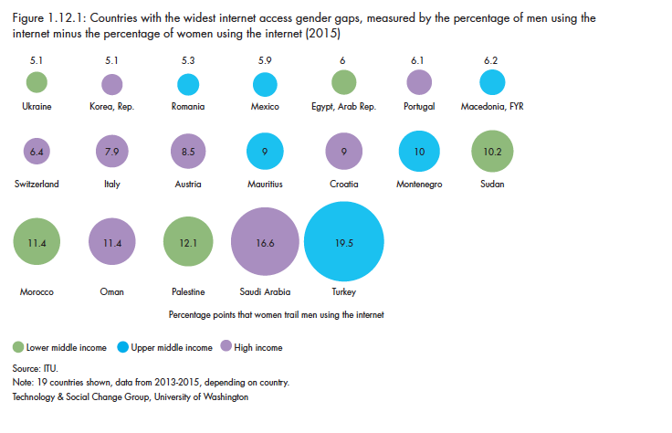
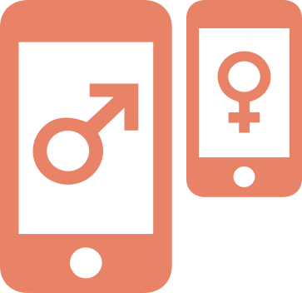
A2I CAPABILITIES: THE GENDER GAP
Almost 40% of women in less-developed regions are now online compared to 80% in more developed regions. The internet user gender gap is the widest in Africa (23%) followed by Arab States (20%)
Notes:
Gender is a key indicator to monitor due to the essential role that women play in development. The correlation between gender equality and development means that promoting information access for women is not only central to success under SDG 5, but also to development generally.
However, according to ITU, the internet user gender gap increased from 11 percent in 2013 to 12 percent in 2016 (ITU, 2016). Africa exhibited the widest gap in 2016 (23 percent) followed by Arab States (20 percent), with the smallest gap in the Americas (2 percent). In terms of actual values, the percentage of women internet users in less-developed regions (37 percent) was much lower than in more developed regions (80 percent), which reflects general trends in internet penetration.
On a country-by-country basis using available ITU data (84 countries surveyed between 2011 and 2015), Turkey, Saudi Arabia, Palestine, Sudan, Morocco, Montenegro, and Croatia exhibit the largest internet use gender gap. (See Figure 1.12.1 for the list of countries with the widest gender gap in 2015.) At the other end of the spectrum, Finland, Ireland, Australia, the United States, Panama, and Jamaica are the first six countries where a higher proportion of women are using the internet than men (proportional to the total population of women).

Slide 21
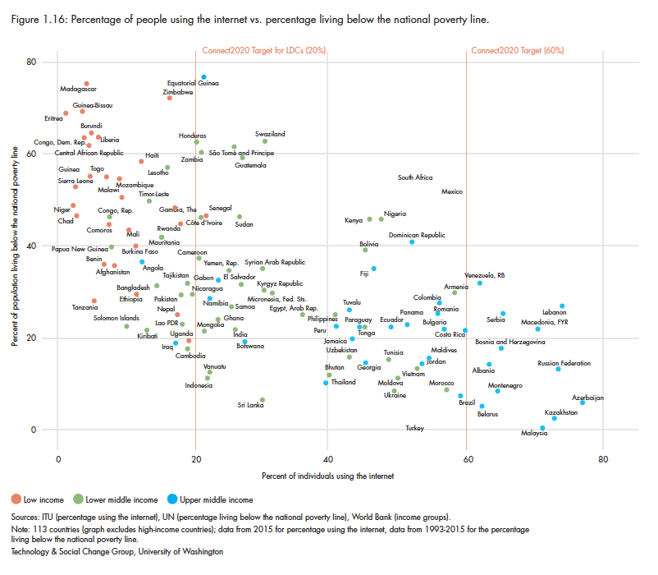
THE SOCIAL CONTEXT OF DA2I: POVERTY
Poverty and economic standing significantly affect people’s ability to use information meaningfully. At the same time, access does offer an avenue for reducing poverty and creating economic opportunity, though what people can do with this access is still bounded by structural inequalities.
Notes:
Poverty affects all aspects of life. Poverty and inequality are among the main drivers constraining people’s agency to live the lives they choose to live, including their ability to use information meaningfully. At the same time, access offers an avenue for reducing poverty and creating economic opportunity. [bit of cutting – some repetition of arguments]
From 2002-2012, the share of people in abject poverty (living below the international poverty line of $1.90 a day, adjusted for purchasing power) dropped from 26 percent to 13 percent (SDGs 2016 Report). If economic growth rates of the past decade continue for the next 15 years and this growth benefits everybody equally, poverty could fall to 4 percent of the population (ibid).
Despite this optimistic forecast, poverty still affects the lives of almost 1 billion people around the world today. Regional poverty rates provide a clearer picture of persistent poverty that is masked by international estimates.
By 2015, close to a third of people around the world lived below national poverty lines – usually calculated as 60% of median income. However, this rose to 45 percent in Sub-Saharan Africa, 37 percent in Oceania, and 27 percent in Latin America. [removed references to other figures]
It would be simplistic to assume that merely expanding internet access will mitigate the structural dimensions of poverty. While improvements in infrastructure and connectivity expand resources and opportunities to a wider segments of the population, the gains that access provides are bounded by larger societal forces. Access is important, but transformational effects require systemic changes. Access is just one piece.
Even though this holds for the poorest countries in the world, it not as clear when we look at countries in the lower-middle-income and upper-middle-income levels. (See Figure 1.16.)
Countries such as South Africa, Brazil, Colombia, Turkey, Costa Rica, Mexico, and Romania, which in general exhibit higher income per capita, have less than 60 percent of their population online. This indicates that access to the internet is not enough, in itself, to improve the lives of people.
There is no question that the highest need at all levels is in the poorest countries. However, the variance in the economic position of several upper-middle and lower middle-income countries begs the question of what is the true impact of access to information on the reduction

Slide 22
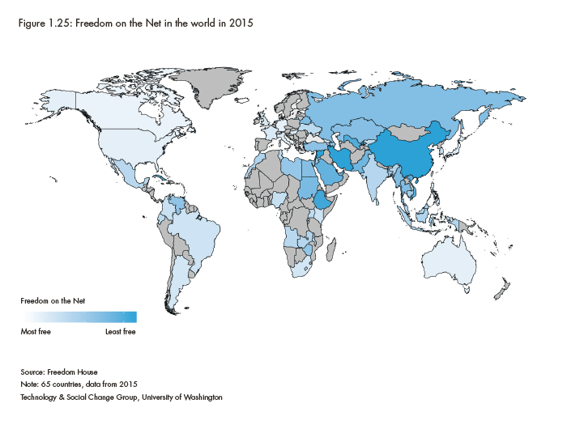
LEGAL CONTEXT OF A2I: FREEDOM ON THE NET
In 2016, 60 percent of internet users lived in countries where people were arrested or imprisoned for posting content on political, social, and religious issues online; while 49 percent of users live in countries where people have been attacked or killed for their online activities. (Freedom House, 2016)
Notes:
According to Freedom House’s 2016 report, internet freedoms have been declining for six years, with Freedom of the Net scores falling in at least half of the countries monitored each year.
The implications are clear: Freedom House estimates that, in the previous 12 months, 60 percent of internet users lived in countries where people were arrested or imprisoned for posting content on political, social, and religious issues; while 49 percent of users live in countries where people have been attacked or killed for their online activities (Internet Society, 2017).

Slide 23
STORIES FROM DA2I: SDG 2
End hunger, achieve food security and improved nutrition and promote sustainable agriculture
AgroLibJa project (Serbia)
Notes:
Farmers in central Serbia lacked the computer skills and network connectivity needed to access information and market their products. To combat this, four village libraries reinvented themselves as information centers through the AgroLibJa project.
In 2010, they purchased computers with a grant from EIFL (Electronic Information for Libraries) Public Library Innovation Programme and offered free internet access, as well as ICT training both for farmers and for the librarians themselves.
It developed a website for the AgroLib project and a portal where local products could be advertised.
The library also acquired up-to-date agricultural literature and hosted presentations by ministry officials about relevant regulations and available subsidies. In villages with few other venues for socializing, libraries also attracted young people.
At project end, AgroLib received a further grant from the Ministry of Culture to extend its activities.

Slide 24
STORIES FROM DA2I: SDG 3
Ensure healthy lives and promote well-being for all at all ages
READ Global rural health libraries (Nepal)
Notes:
In health emergencies, libraries can go beyond being information distributors to become part of a two-way communication between those affected and those trying to help.
In Nepal in the aftermath of the 2015 earthquake, the READ Global rural health libraries found themselves becoming hubs for medical care and shelter, and providing access to electricity for charging mobile devices as well as internet connections. Such activities are not restricted to lower-income countries.
In 2012, for example, libraries in New Jersey and Connecticut in the eastern United States were able to provide safe community spaces and access to information for those forced from their homes or left without power or internet connections after a hurricane (Bayliss, 2012).

Slide 25
STORIES FROM DA2I: SDG 5
Achieve gender equality and empower all women and girls
Infocentros (Chile)
Notes:
Chile has a network of some 400 library-based Infocentros.
They offer free public non-commercial access to the internet, with a special effort to ensure gender balance. Special efforts are made to ensure women, as well as other vulnerable groups, were able to make use of this service, by providing a safe, secure, and non-judgemental space for information gathering.
Indeed, while overall internet use in Chile is balanced between men and women, 65 percent of those enrolled in the free information technology classes were women. These classes also did not force women to use their skills in one way or another. Infocentros are women-friendly, as opposed to cybercafés, where majority of users are male.
Access is provided for wheelchairs and baby strollers. Female users can talk and help each other as well as get help from the (most often) female directors of the centers, in a way that they couldn’t from and with men.
The center becomes a meeting place for women where they use their social resources for information empowerment.

Slide 26
STORIES FROM DA2I: SDG 9
Build resilient infrastructure, promote inclusive and sustainable industrialization and foster innovation
Business and IP Centre (United Kingdom)
Notes:
High-quality, publicly available information can also be a significant factor in the success of small businesses and self-employed people, helping them to innovate and adopt more efficient practices.
In 2006, the British Library opened a Business and IP Centre in London to provide specialized support for small businesses. The center offers users access to a comprehensive collection of databases and publications, plus a program of practical workshops, one-on-one advice sessions and inspiring talks.
The center has been extraordinarily successful. Over the past decade, more than 500,000 people have used the service, including more than 60,000 visitors in 2016 (British Library 2016).
Many other libraries are following suit, recognizing the potential advantages for small businesses in having access to information (British Library, 2016)

Slide 27
LEARN MORE: DA2I.IFLA.ORG
Notes:
To learn more about the DA2I, access more data facts and essays, check the DA2I website!

Slide 28
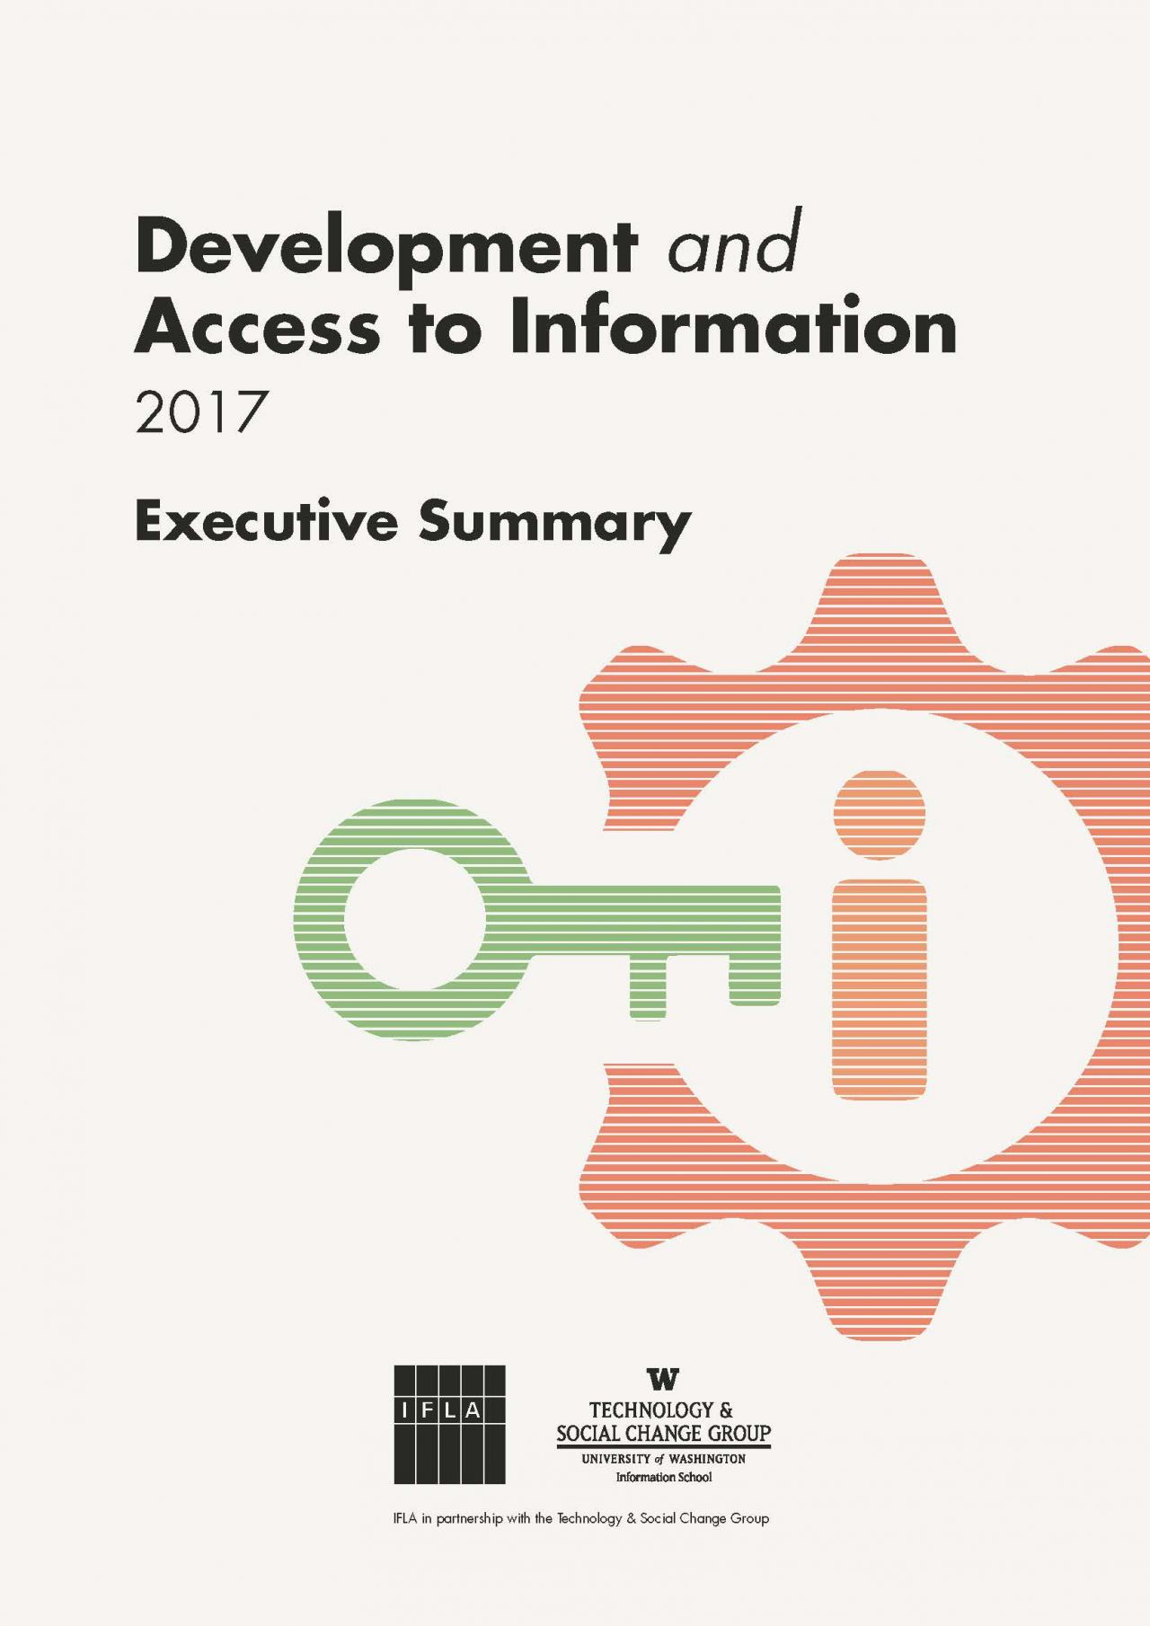
DA2I EXECUTIVE SUMMARIES
Arabic
Chinese
English
French
German
Russian
Spanish

Slide 29
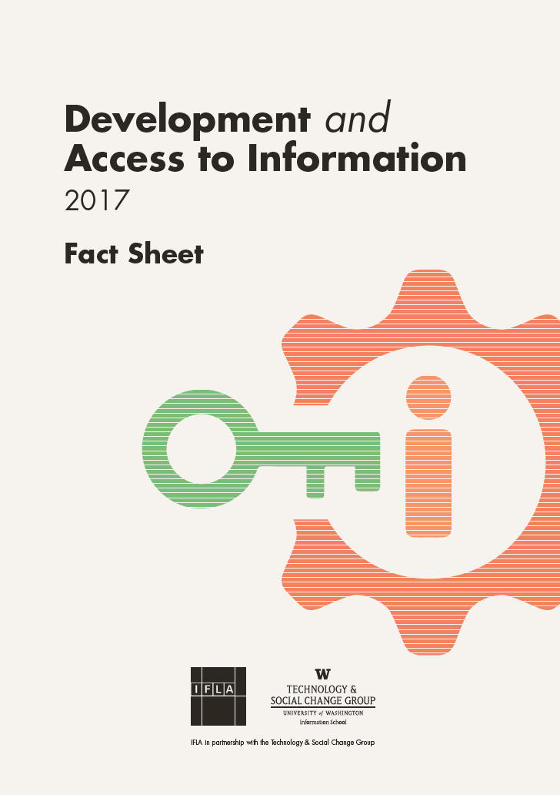
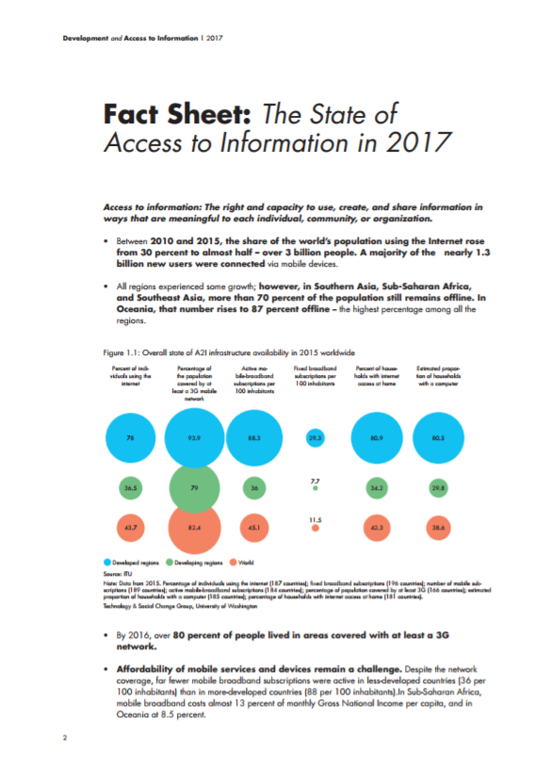
DA2I FACT SHEET: THE DATA

Slide 30
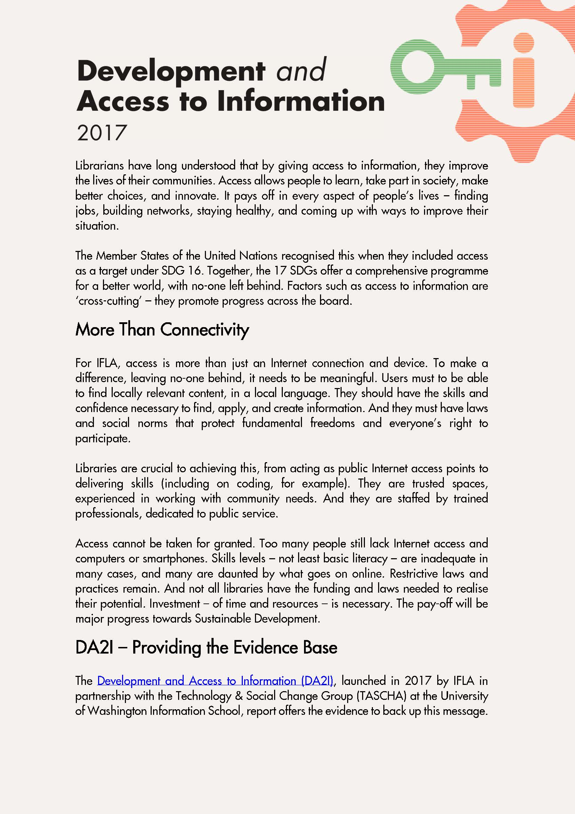
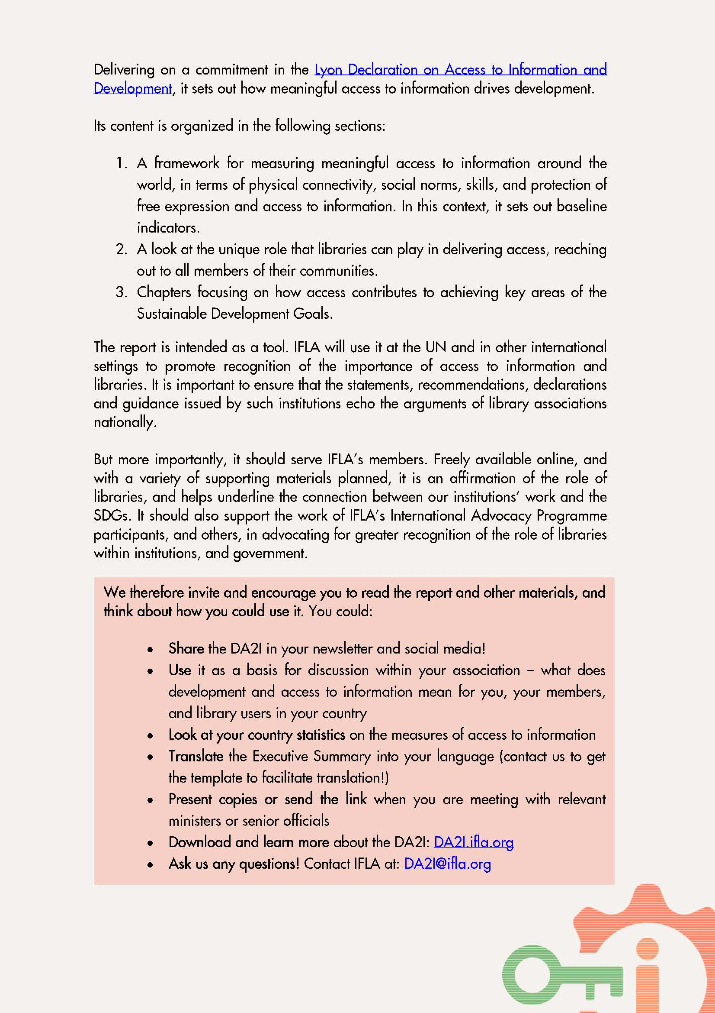
DA2I LEAFLET: HOW TO USE THE DA2I REPORT

Slide 31
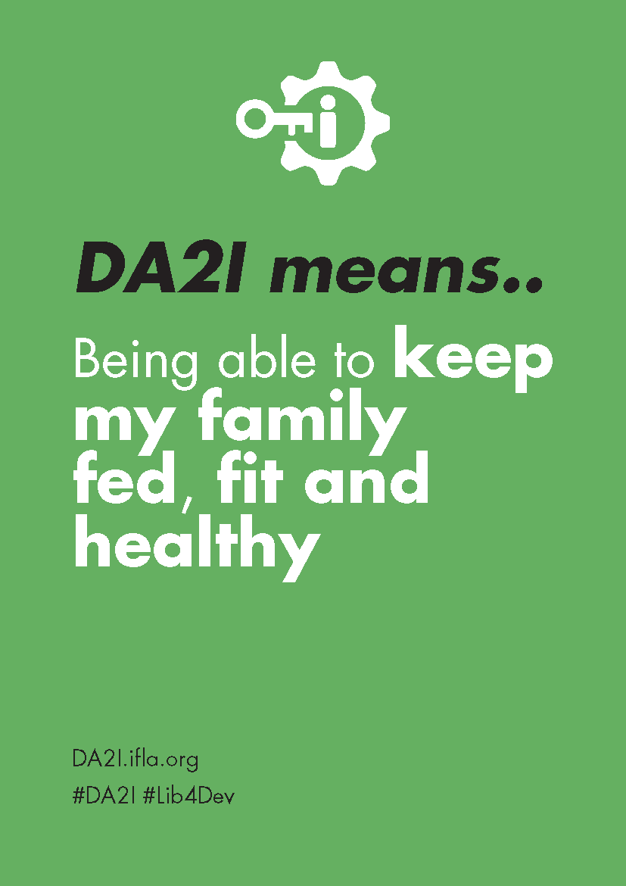
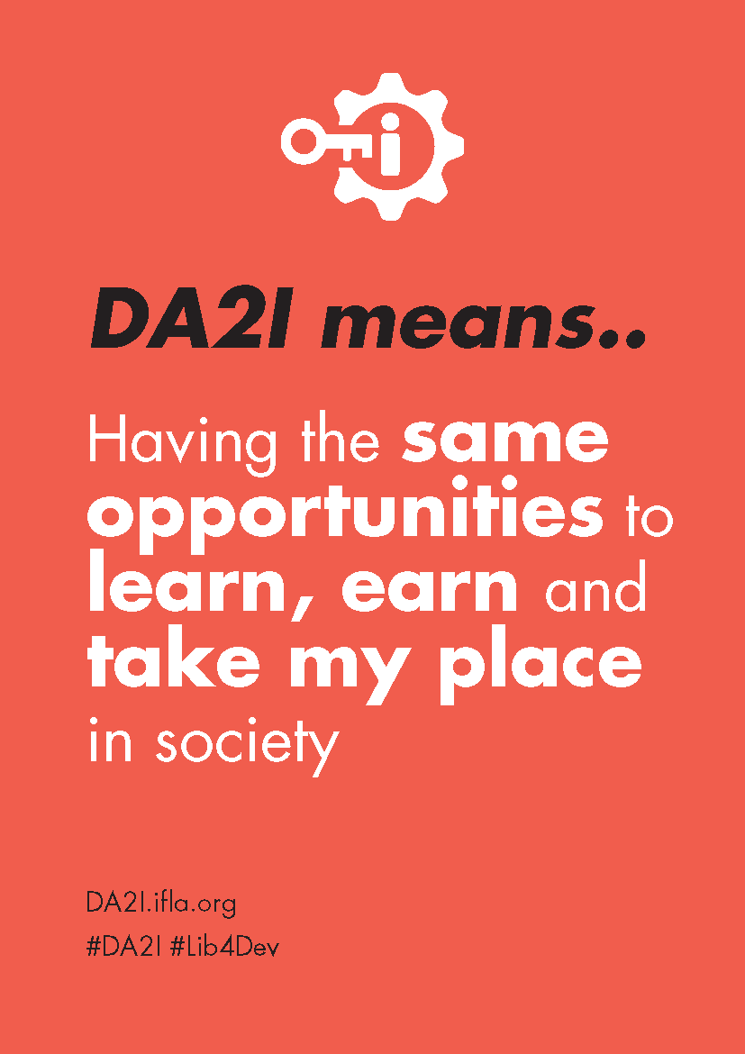
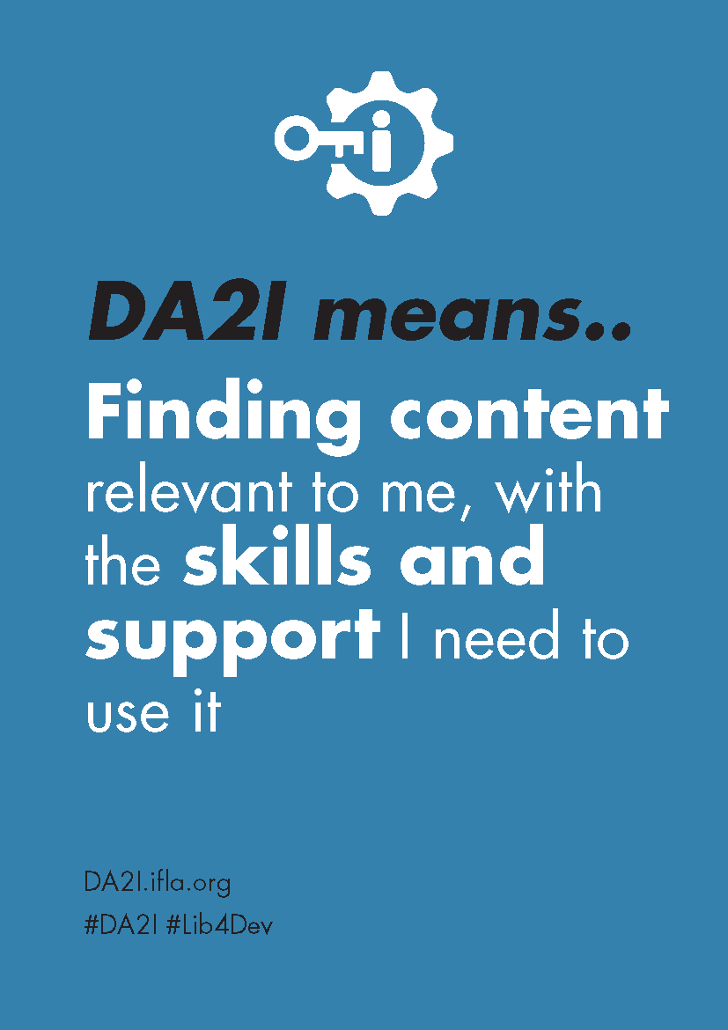
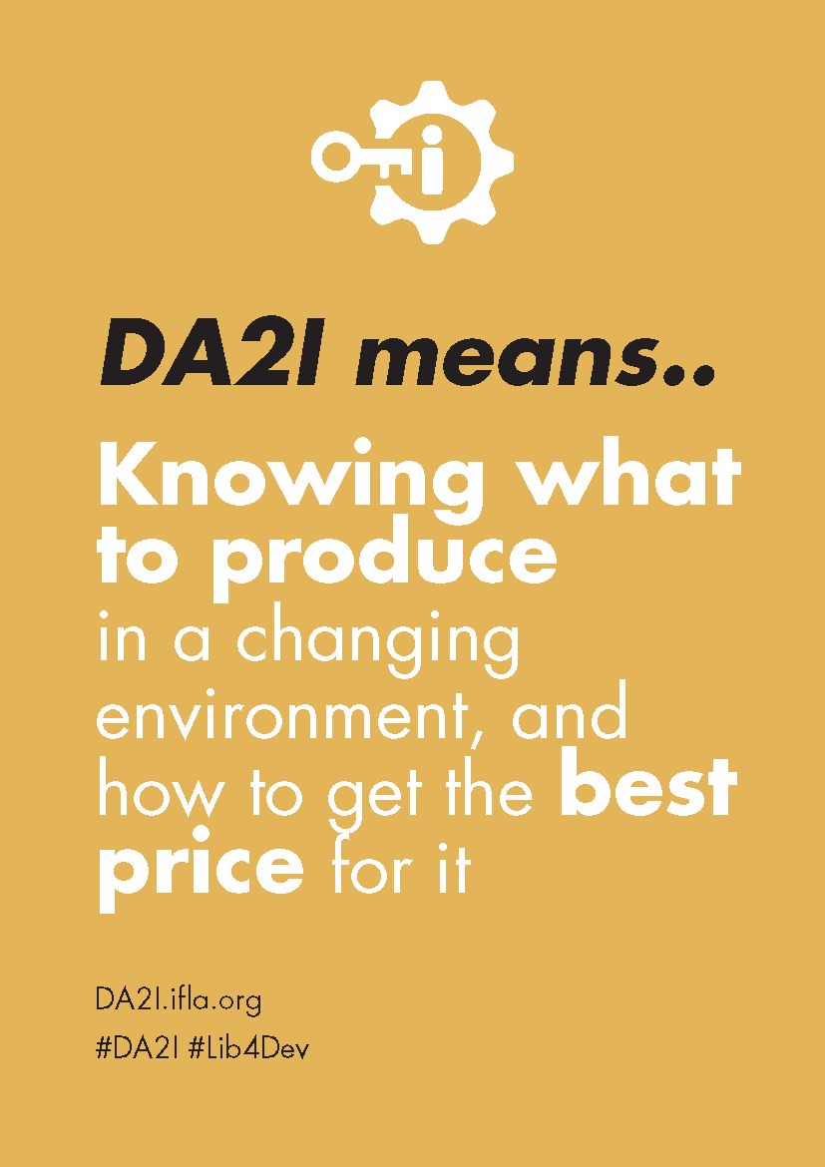
DA2I POSTCARDS: WHAT DOES IT MEAN

Slide 32
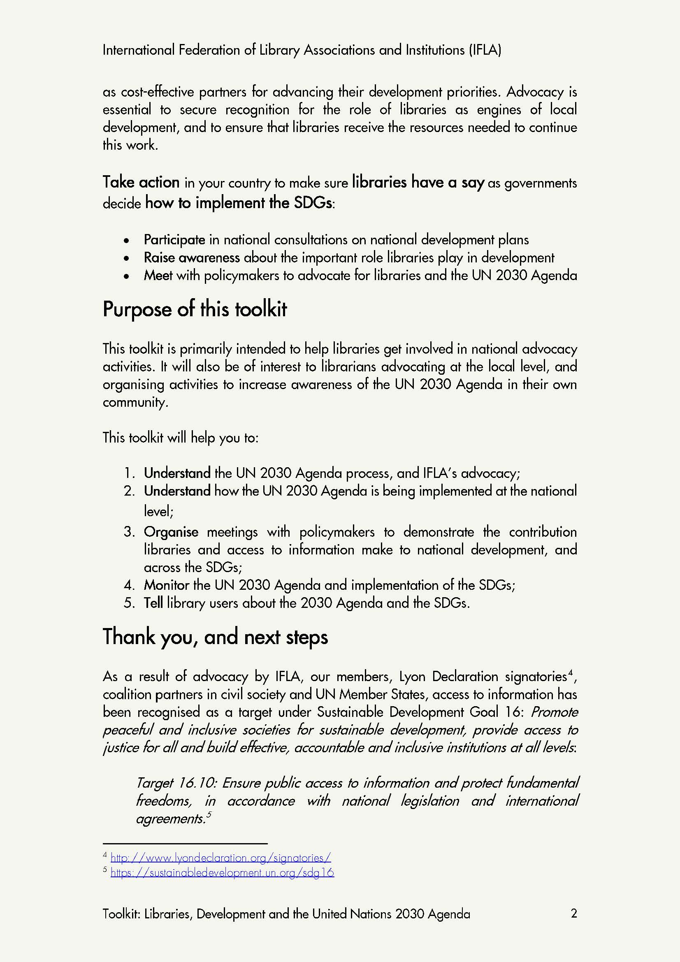
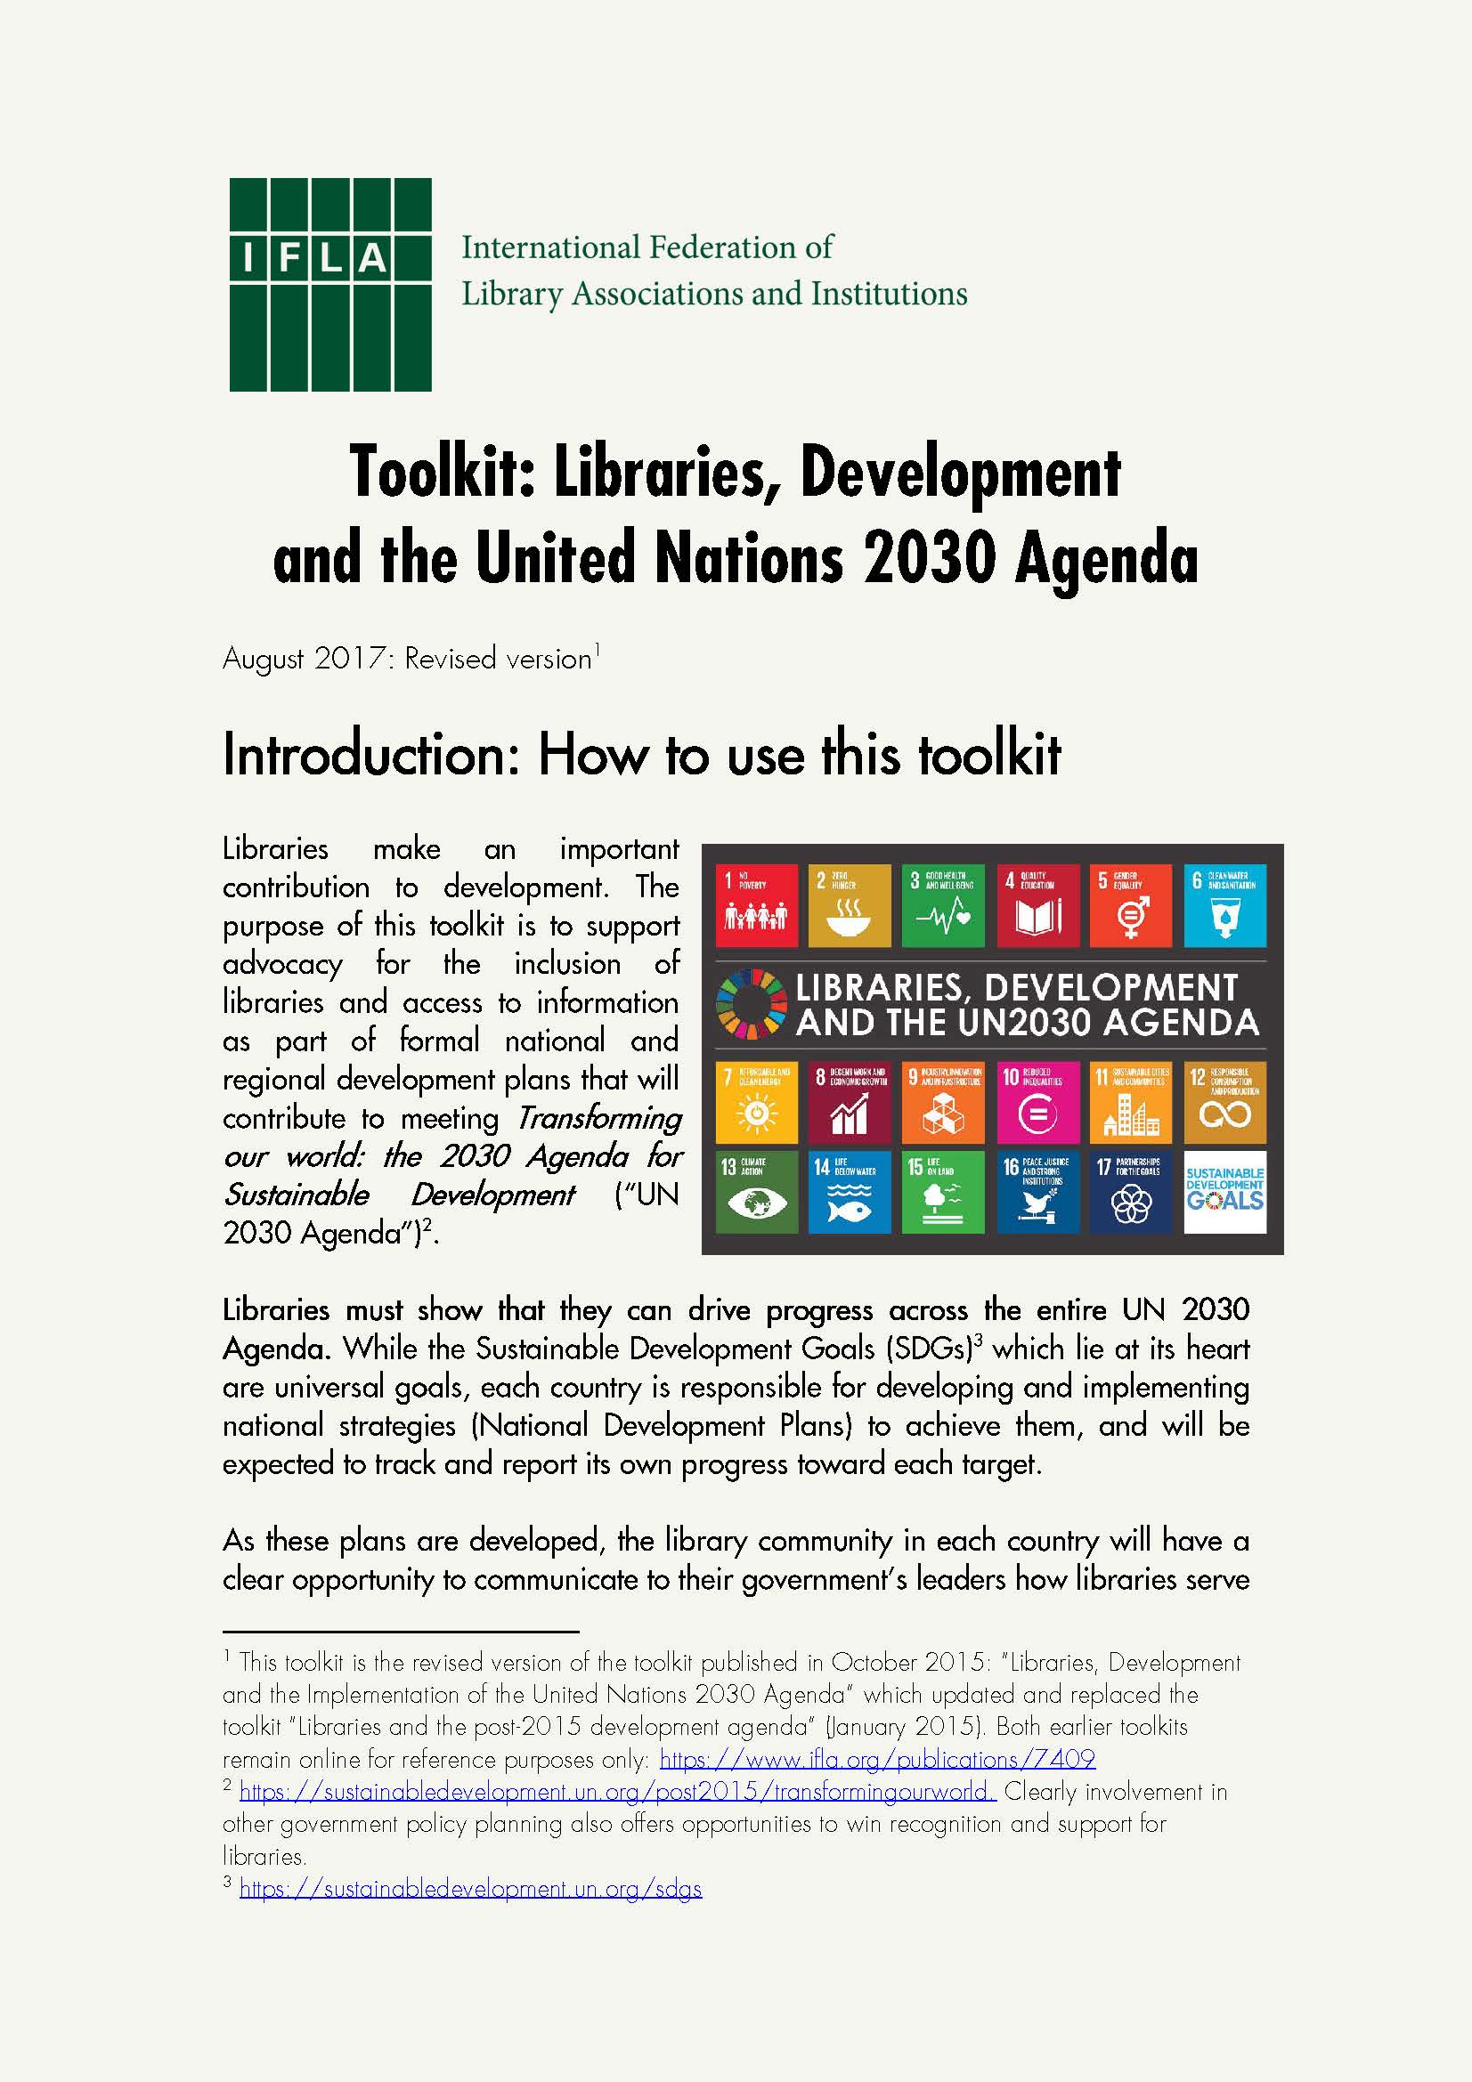
IFLA TOOLKIT
REVISED VERSION
August 2017

Slide 33
HIGH LEVEL POLITICAL FORUM 2017
New York, 10-17 July 2017
43 Voluntary National Reviews
Theme: "Eradicating poverty and promoting prosperity in a changing world“
Focus SDGs:
Goal 1. No poverty
Goal 2. Zero hunger
Goal 3. Good health and well-being
Goal 5. Gender equality
Goal 9. Industry, innovation and infrastructure
Goal 14. Life below water
Notes:
The High-level Political Forum, is the United Nations central platform for follow-up and review of the 2030 Agenda for Sustainable Development and the Sustainable Development Goals. It provides for the full and effective participation of all States Members of the United Nations and States members of specialized agencies.
HLPF 2017 in New York, focus on SDGs 1, 2, 3, 5, 5, 9, 14
As part of its follow-up and review mechanisms, the 2030 Agenda for Sustainable Development encourages member states to “conduct regular and inclusive reviews of progress at the national and sub-national levels, which are country-led and country-driven” (paragraph 79).
These national reviews are expected to serve as a basis for the regular reviews by the high-level political forum (HLPF), meeting under the auspices of ECOSOC.
As stipulated in paragraph 84 of the 2030 Agenda, regular reviews by the HLPF are to be voluntary, state-led, undertaken by both developed and developing countries, and shall provide a platform for partnerships, including through the participation of major groups and other relevant stakeholders.
The voluntary national reviews (VNRs) aim to facilitate the sharing of experiences, including successes, challenges and lessons learned, with a view to accelerating the implementation of the 2030 Agenda.
The VNRs also seek to strengthen policies and institutions of governments and to mobilize multi-stakeholder support and partnerships for the implementation of the Sustainable Development Goals. Indeed, many will include civil society representatives in their delegations in order to underline this point.
The VNR countries are expected to submit comprehensive written reports and main messages summarizing their key findings. While there is no standard format, they offer an opportunity to encourage member states to fulfil their commitments.

Slide 34
VOLUNTARY NATIONAL REVIEWS 2017
Notes:
On 2017 there were: 43 Voluntary National Reviews
In this map you can see the regional distribution of countries volunteering for reviews.
11 LAC
12 Europe
7 Africa
13 Asia Oceania

Slide 35
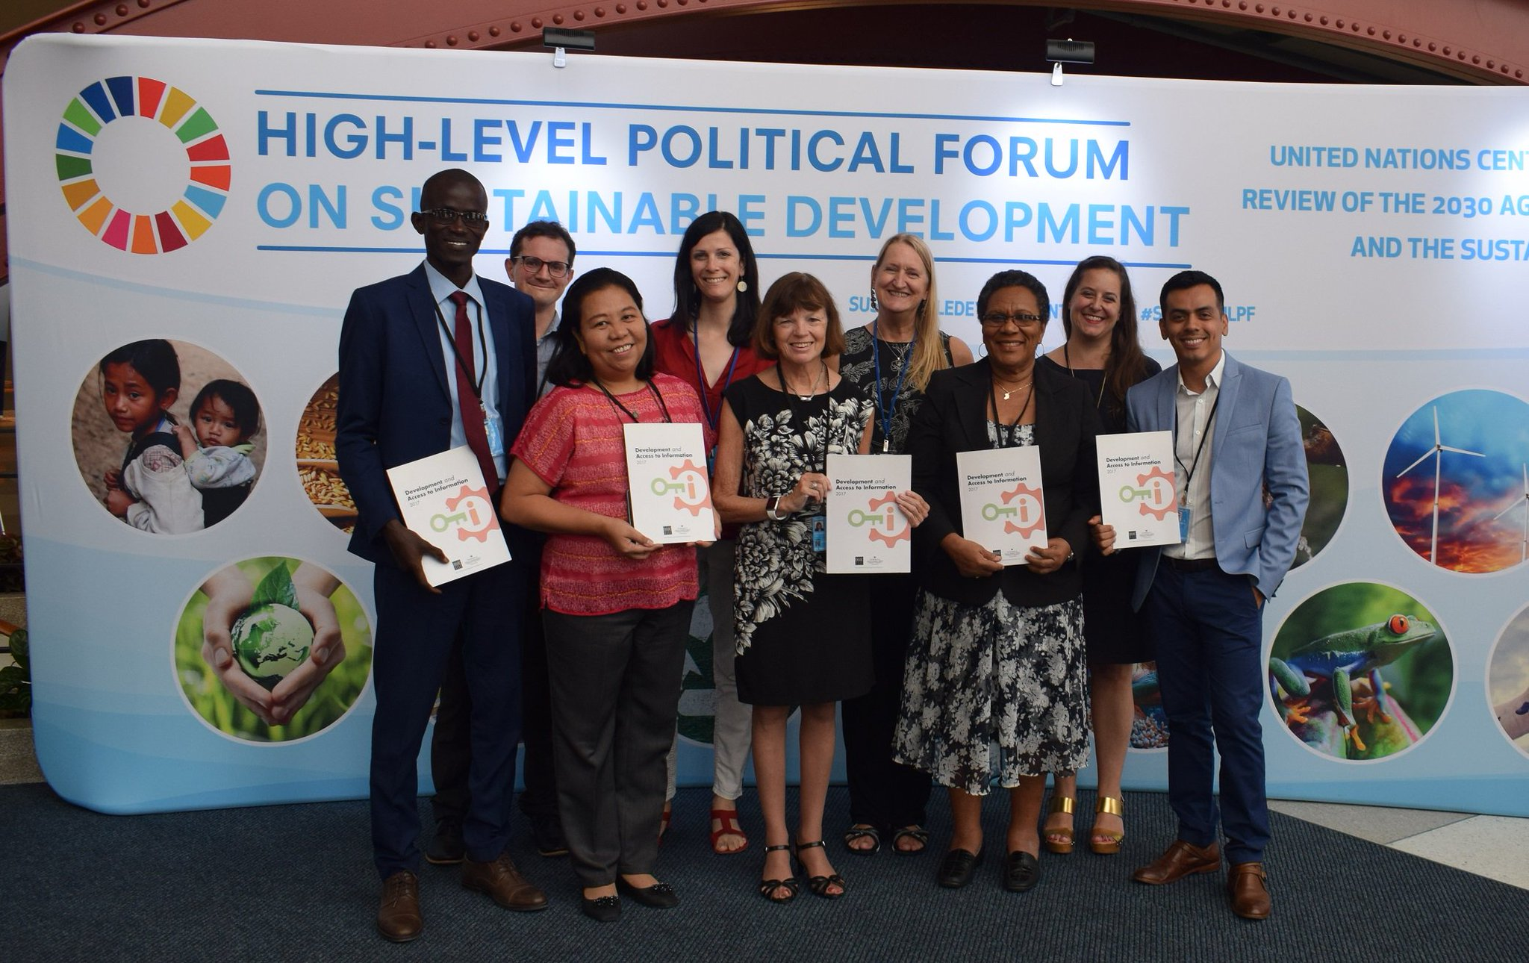
IFLA DELEGATION AT THE HLPF
Notes:
IFLA was active at the UN High Level Political Forum (HLPF) – the most important event of the year relating to the UN SDGs – where we were advocating for access to information and libraries’ contribution to development.
IFLA President Donna Scheeder
IFLA Leaders representing four regions: Mandiaye Ndiaye (Africa), Jonathan Hernández (LAC), Vesna Vuksan (Europe) and Elvira Lapuz (Asia Oceania)
Helena Asamoah-Hassan (Executive Director of the African Library and Information Associations and Institutions – AfLIA and Mentor of the ILP)
IFLA Manager Policy and Advocacy Stephen Wyber
IFLA Manager Development Programmes Ingrid Bon
And I, Advocacy Communications Officer

Slide 36
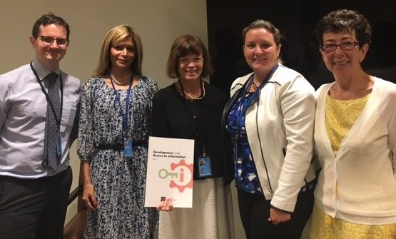
SIDE EVENT AT THE UNITED NATIONS
11 July 2017
United Nations Headquarters
Speakers: IFLA President 2015-2017 Donna Scheeder, Maria Garrido (TASCHA), Nancy Hafkin (Women in Global Science and Technology), Quinn McKew (Article 19)
Moderator: IFLA Manager of Policy and Advocacy, Stephen Wyber
Notes:
On 11 July, IFLA’s side-event “Making development smart and inclusive: How access to information can deliver the SDGs” at the United Nations Headquarters was an opportunity to share the report’s findings and messages with government officials, development practitioners and civil society. Participants discussed how both to measure and increase the impact of access to information towards the achievement of the SDGs.
IFLA President, Donna Scheeder, alongside Maria Garrido (Technology and Social Change Group), Nancy Hafkin (Women in Global Science and Technology) and Quinn McKew (Deputy Executive Director, Article 19), set out the report’s key arguments: that access to information is a pre-condition for development across the board, and that for this access to be meaningful, it requires investment and support. Libraries have a unique role in providing this support, especially for those who need it most.
With the drive to eradicate poverty a key theme of this year’s HLPF, Donna Scheeder underlined the risk of information poverty. For individuals faced with low education and skills, poor health and employment performance, and politics driven by misinformation and ignorance, the outlook would be bleak.
There was a positive scenario though, with empowered and critical citizens able to improve their own, and their communities’ lives through better health, good jobs, innovation, creativity and civic engagement. Libraries would be at the heart of this work.
Maria Garrido set out the indicators chosen for the DA2I report, focusing on different dimensions of access –technical, skills-based, cultural and legal. Nancy Hafkin, drawing on long experience of working to give women the same rights and opportunities as men, underlined the risk that without action, inequalities in the physical world would just be replicated in the digital.

Slide 37
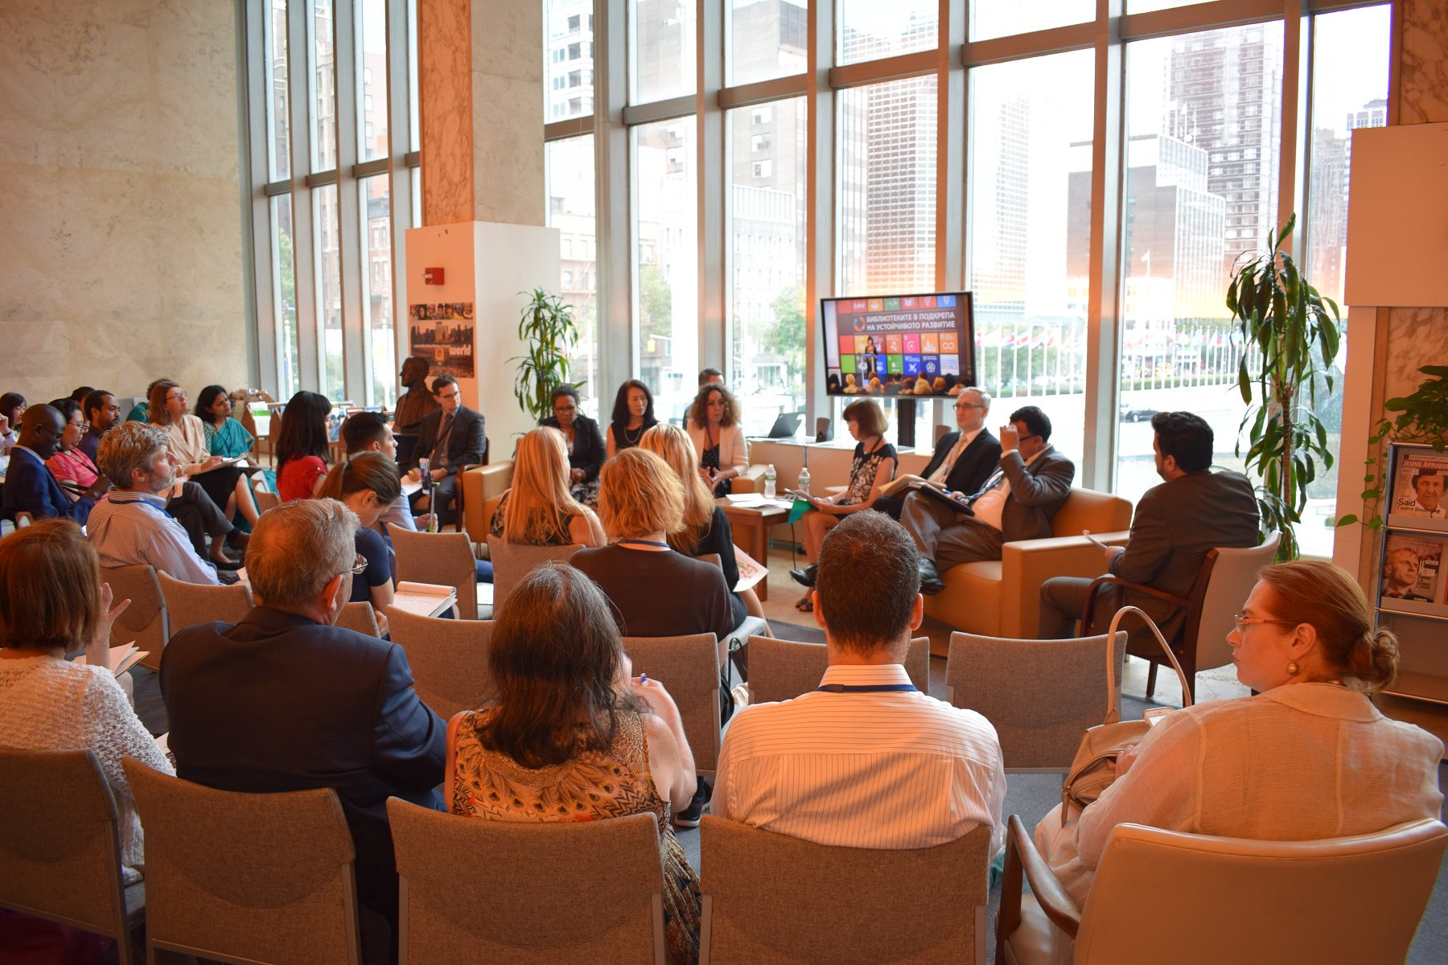
SIDE EVENT AT THE UN LIBRARY
13 July 2017
The Dag Hammarskjöld Library
Speakers: IFLA President 2015-2017, Donna Scheeder; Maria Garrido (TASCHA); Helena Asamoah-Hassan (AfLIA); three development experts working for the United Nations Department of Economic and Social Affairs (DESA)
Moderators: Thanos Giannakopoulos (Chief of the DHL) & IFLA Manager of Policy and Advocacy, Stephen Wyber
Notes:
The DA2I side event “2030 Vision: How Libraries Support the UN’s Work on Sustainable Development” was a unique opportunity to highlight and illustrate the major role of libraries in delivering effective and meaningful access to information driving progress for development at the national and global levels.
The event kicked off with a welcome from the host, Thanos Giannakopoulos, Chief of the DHL. He recognized DA2I as an ambitious endeavour that offers inspiration as well as a roadmap for changing and transforming communities through libraries. As he underlined, “Libraries, supported by policies, can advance the SDGs. The achievement of the SDGs can only be advanced by access”.
The introduction was followed by a lead intervention by IFLA President Donna Scheeder, outlining IFLA’s advocacy work to ensure the inclusion of access to information in the UN 2030 Agenda. She explained why it is crucial for governments to invest in libraries, and give them the laws they need, if they are to leverage them as invaluable partners in development. She remarked that “there is no truly sustainable development without access to information, and no meaningful, inclusive access to information without libraries. The DA2I report, to be launched next Monday, makes the case”.
Maria Garrido (Senior Researcher at the Technology and Social Change Group, University of Washington) spoke about the DA2I Report. Her intervention introduced the DA2I project and first report, and focused particularly in the conceptual framework, including the dimensions that influence access to information and its ability to advance the SDGs. She set out details about the baseline indicators of the first DA2I report and next steps, but stressed: “We need more data, and we need better data, and the DA2I report is a first step to achieve this”.
With a presentation “Putting (UN) information to work on the ground – the case of Ghana”, Helena Asamoah-Hassan showed how the work of libraries in Africa is driving progress towards the achievement of different SDGs, particularly quality education, gender equality and inclusive societies.
The event included the participation of development experts working for the United Nations Department of Economic and Social Affairs (DESA), who offered their perspectives on access to information and libraries: Sami Areikat, (Sustainable Development Officer, Division for Sustainable Development), Richard Alexander Roehrl (Senior Economic Affairs Officer, Division for Sustainable Development), and Wenyan Yang (Chief of Service, Social Perspective on Development Branch). In their interventions they shared experiences related to the information access needed to perform their work and highlighted the key role libraries play in facilitating policy-relevant research. Libraries were crucial for work on the SDGs at the highest level.

Slide 38
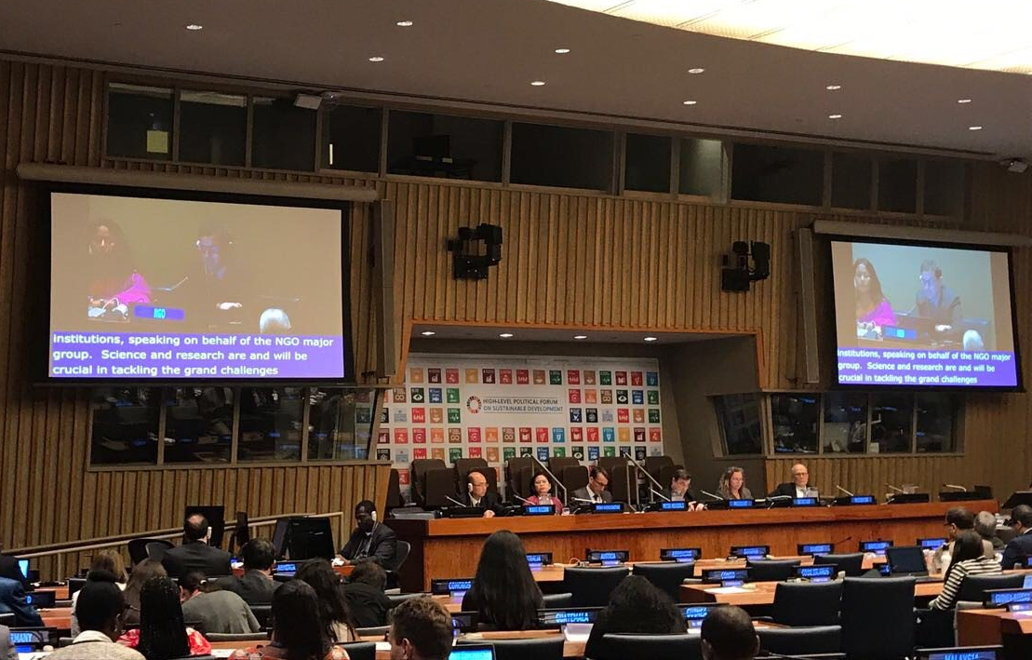
IFLA SPEAKS AT THE HLPF 2017
14 July 2017
IFLA Manager of Policy and Advocacy, Stephen Wyber
HLPF session "Science-policy interface and emerging issues"
On behalf of the NGO Major Group
Call on Member States and the UN to promote Open, Inclusive Access to Information
Notes:
On Friday 14 July, at the main session of the United Nations High Level Political Forum: "Science-policy interface and emerging issues", IFLA intervened, speaking on behalf of the NGO Major Group. The session focused on Science-Policy interactions, namely the need to make more effective connections between research and policy making.
IFLA underlined the need for meaningful access to information in order to succeed in the UN 2030 Agenda. Libraries play an essential role, both in supporting research within and across institutions, but also in bringing the results to wider society.
IFLA also highlighted the importance of Open Access, and called on the UN to take the lead by adopting its own policy.

Slide 39
LAUNCH EVENT IN NEW YORK
17 July 2017
The New York Public Library
Key target: Permanent Representatives of Member States to the United Nations, United Nations officials, civil society, tech companies, library representatives, media
Speakers:
Opening and Closing by IFLA Secretary General Gerald Leitner
Address by IFLA President 2015-2017 Donna Scheeder
Maher Nasser (UN Acting Under-Secretary General for Communications)
Chris Coward (Co-Founder and Director of TASCHA)
Nick Ashton Hart
Vusumuzi Ntonga (Deputy Permanent Representative of Zimbabwe to the UN)
Notes:
The report was officially launched on 17 July 2017 at The New York Public Library at a high-level event that included the participation of Permanent Representatives of Member States to the UN, United Nations officials, Civil Society leaders, other development stakeholders, as well as library representatives of the New York area, and specialised press.
Speakers:
Opening and Closing by IFLA Secretary General Gerald Leitner
Address by IFLA President Donna Scheeder
Maher Nasser (UN Acting Under-Secretary General for Communications)
Chris Coward (Co-Founder and Director of TASCHA)
Nick Ashton Hart
Vusumuzi Ntonga (Deputy Permanent Representative of Zimbabwe to the UN)

Slide 40
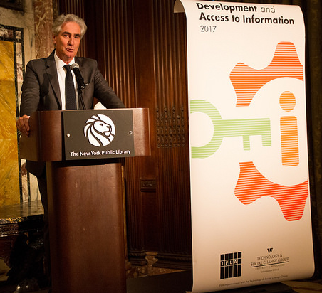
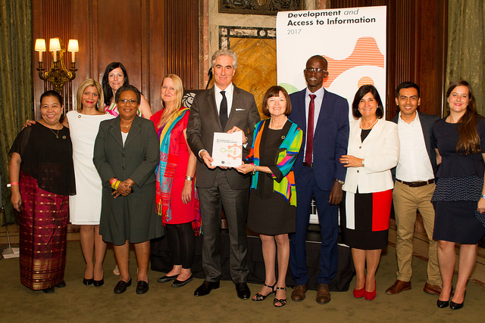
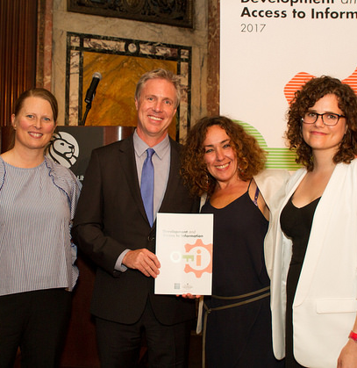
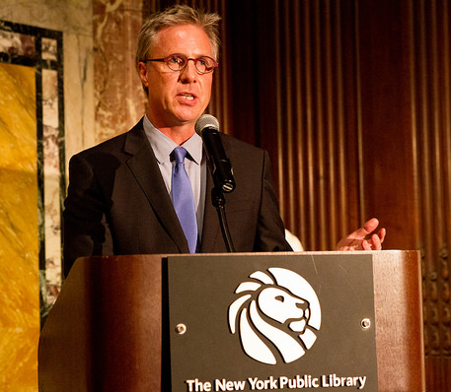
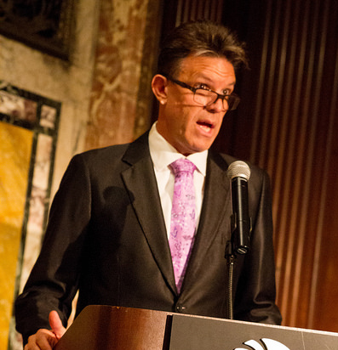
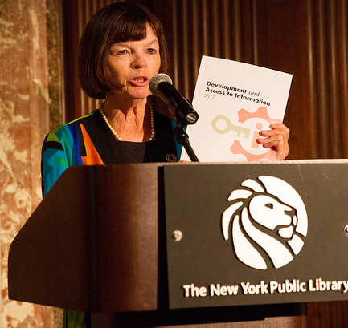
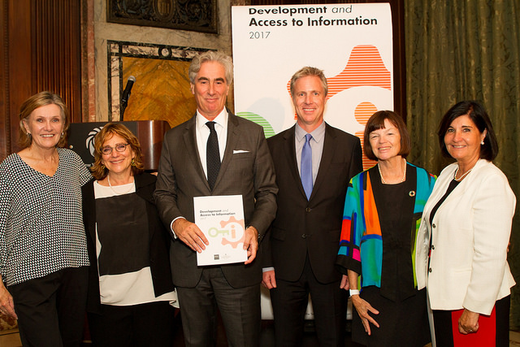
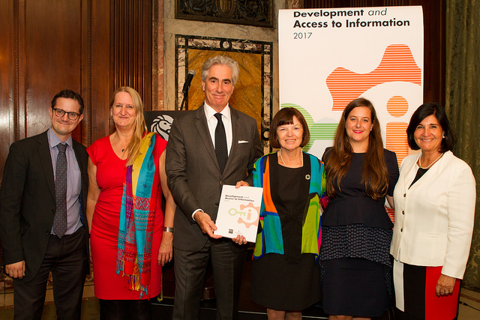
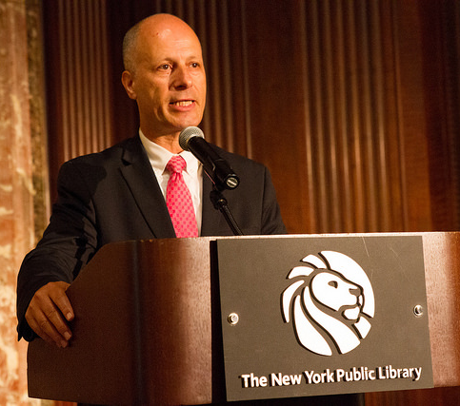
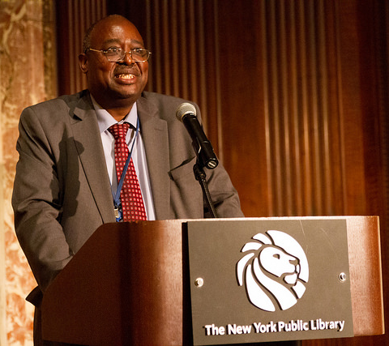
LAUNCH EVENT IN NEW YORK
Notes:
Speakers:
Opening and Closing by IFLA Secretary General Gerald Leitner
Address by IFLA President Donna Scheeder
Maher Nasser (UN Acting Under-Secretary General for Communications)
Chris Coward (Co-Founder and Director of TASCHA)
Nick Ashton Hart
Vusumuzi Ntonga (Deputy Permanent Representative of Zimbabwe to the UN)

Slide 41
HIGH LEVEL POLITICAL FORUM 2018
48 Voluntary National Reviews
Theme: “Transformation towards sustainable and resilient societies”
Focus SDGs:
Goal 6. Clean water and sanitation
Goal 7. Affordable and clean energy
Goal 11. Sustainable cities and communities
Goal 12. Responsible consumption and production
Goal 15. Life on land
Notes:
48 Voluntary National Reviews in 2018 (the list is now closed: https://sustainabledevelopment.un.org/content/documents/16985Letter_ECOSOC_President_VNRs_and_closing_country_list_for_2018_HLPF_14Sept17.pdf)
Theme: “Transformation towards sustainable and resilient societies”
Focus SDGs:
Goal 6. Clean water and sanitation
Goal 7. Affordable and clean energy
Goal 11. Sustainable cities and communities
Goal 12. Responsible consumption and production
Goal 15. Life on land
These are all areas where, once again, the role of access to information, and libraries in particular, will be strong. SDG11 is particularly important for libraries, given that it includes not only community building – a particular strong point for public libraries – but also safeguarding cultural heritage.

Slide 42
HIGH LEVEL POLITICAL FORUM 2019
Theme: “Empowering people and ensuring inclusiveness and equality”
Focus SDGs:
Goal 4. Quality education
Goal 8. Affordable and clean energy
Goal 10. Reduced inequalities
Goal 13. Climate action
Goal 16. Peace, justice and strong institutions
2016-2019: one “cycle” of HLPF sessions under ECOSOC auspices. At the conclusion of the cycle, the UN General Assembly will also convene an HLPF. This year two sessions of the Forum will take place.
Notes:
Theme: “Empowering people and ensuring inclusiveness and equality”
Focus SDGs:
Goal 4. Quality education (VERY RELEVANT)
Goal 8. Affordable and clean energy
Goal 10. Reduced inequalities
Goal 13. Climate action
Goal 16. Peace, justice and strong institutions (ALSO VERY RELEVANT)
2019 will be also a particular year for the SDGs: 2016-2019 closes one “cycle” of HLPF sessions under ECOSOC auspices. At the conclusion of the cycle, the UN General Assembly will also convene an HLPF. This year two sessions of the Forum will take place.
The review of progress overall is an opportunity to highlight how the framework, and the indicators used could be better.

Slide 43
NEXT STEPS
DA2I side events around the world
Preparations for DA2I 2018 (and 2019)
Help IFLA members, IAP participants, and the library community worldwide to use the DA2I as an advocacy tool to get libraries on the agenda
Continue spreading the word!
Notes:
DA2I side events around the world
Preparations for DA2I 2018 (and 2019)
Help IFLA members, IAP participants, and the library community worldwide to use the DA2I as an advocacy tool to get libraries on the agenda
Continue spreading the word!

Slide 44
THANK YOU!
DA2I.ifla.org
www.ifla.org/libraries-development
@IFLA @IFLA_Lib4Dev IFLA
#DA2I #Lib4Dev
DA2I@ifla.org

