Slide 1
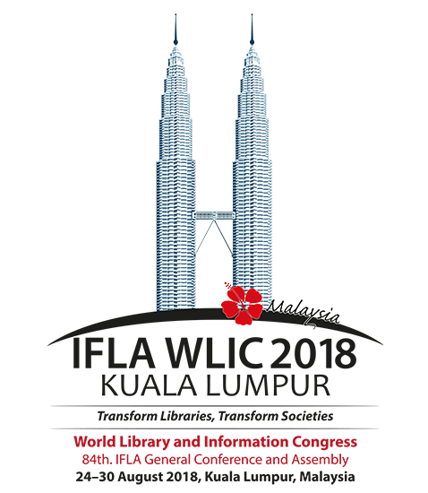
School Libraries
27th of August 2018
Session 151
Presentation of the coming book:
Global Action on School Library Education and Training
<numéro>

Slide 2
Part II : Educating the School Library Professional
Chapter 5
The Initial Training of Teacher Librarians in France: Towards the Construction of a Faceted Professional Identity
Authors : Pascale Peurot, Cécile Chabassier,
Anaïs Denis, Valérie Glass and Magali Bon

Slide 3
Centres de documentation et d’information (Cdi) : THE NATIONAL FRAMEWORK

Slide 4
CENTRES DE DOCUMENTATION ET D’INFORMATION (CDI) : THE NATIONAL FRAMEWORK
1973 : Creation of the first French school libraries called « Centres de documentation et d’information » (CDI) run by school librarians called « Documentalistes-bibliothécaires »
1977 : 1st mission statement
1986 : 2nd mission statement
The role of the staff working in the CDIs are at the crossroads of 3 approaches :
Educational
Documentary
Cultural

Slide 5
CENTRES DE DOCUMENTATION ET D’INFORMATION (CDI) : THE NATIONAL FRAMEWORK
1972 : Creation of FADBEN (national association of « professeurs documentalistes »)
1989 : creation of CAPES (the secondary school teaching certificate) and implementation
of a CDI in each secondary school. French teacher librarians are called « Professeurs documentalistes »

Slide 6
CENTRES DE DOCUMENTATION ET D’INFORMATION (CDI) : THE NATIONAL FRAMEWORK
Evolution of professeurs documentalistes’ missions towards a more assertive specialisation in the field of information and communication sciences as well as an increased responsibility within the school.
2 recent official texts published by the Ministry of Education:
2013 : Reference System attached to the teaching professions
2017 : New mission statement for Professeurs documentalistes which states that « The professeur documentaliste is teacher and master of the acquisition by all students of a media and information culture »

Slide 7
CENTRES DE DOCUMENTATION ET D’INFORMATION (CDI) : THE NATIONAL FRAMEWORK
Lack of consistency from the educational institution regarding professeurs documentalistes’ pedagogical mission :
Teachers without a school curriculum and assigned classes
Teachers who have to define themselves a precise curriculum in the field of information literacy and find themselves strategies to ensure effective learning.

Slide 8
CENTRES DE DOCUMENTATION ET D’INFORMATION (CDI) : THE NATIONAL FRAMEWORK
Since 2013 : a new framework in the teachers' initial training in France with the creation of the master’s degree MEEF (Métiers de l'Enseignement, de l'Éducation et de la Formation) delivered in 32 ÉSPÉ (École Supérieure du Professorat et de l'Éducation) throughout France
ÉSPÉ’ objectives : to provide an academic structure that brings together university lecturers and researchers, instructors-practitioners and practitioners (secondary teachers, chief education advisers, headmasters, and inspectors) to train professionals in reflective practices

Slide 9
CENTRES DE DOCUMENTATION ET D’INFORMATION (CDI) : THE NATIONAL FRAMEWORK
Initial training of professeurs documentalistes
To follow a two-year training programme that prepares them for the CAPES (the secondary school teaching certificate)
After successfully passing the national competitive examination, the CAPES (which can be obtained during the first year of master’s studies or later), the successful candidates are interns for one year before becoming permanent civil servants on completion of the master’s degree and internship

Slide 10
THE UNIVERSITY TRAINING AT THE éSPé OF THE ACADEMY OF LIMOGES

Slide 11
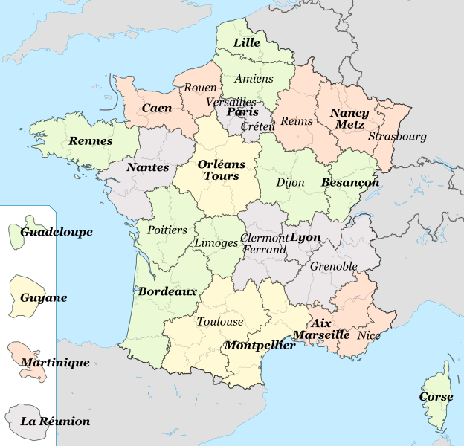
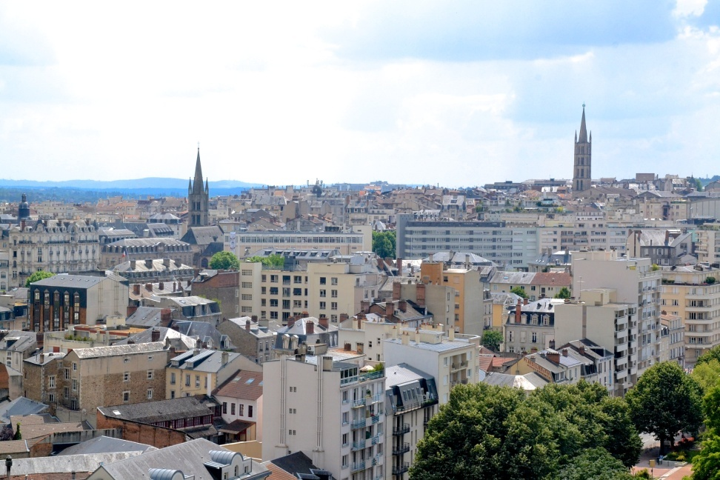
THE UNIVERSITY TRAINING AT THE éSPé OF THE ACADEMY OF LIMOGES
Source : https://fr.wikipedia.org/wiki/Fichier:Centre-ville_de_Limoges_depuis_la_gare.JPG
Source : https://fr.wikipedia.org/wiki/Fichier:French_academies_map.svg

Slide 12
THE UNIVERSITY TRAINING AT THE éSPé OF THE ACADEMY OF LIMOGES
16 000 students at the University of Limoges
ESPE, part of the University of Limoges, welcomes about 700 students
About 20 students in the master of Teacher Librarianship called «MEEF Professeur Documentaliste »

Slide 13
THE CONTENT OF THE éSPé TRAINING

Slide 14
THE CONTENT OF THE éSPé TRAINING
IFLA School Library Guidelines
Master degree MEEF Documentation
“the curriculum should include, in addition to the core competencies of librarianship, an understanding of education (learning, curriculum, teaching), of digital technology and social media, and of youth, culture, and literacies”
“collaboration is an essential part of a school librarian’s work
specific teaching on information literacy and its implementation in the school context (707 hours)
common teaching for groups of students from all subjects about the practical context and teacher's posture (108 hours)
includes an educational and pedagogical approach for digital tools, validated by a certification
3 days per week at the ESPE completed by internships periods.
Common core : Exchange and cooperation with students from other subjects in order to develop the common culture and mutual knowledge necessary for professional collaboration

Slide 15
THE CONTENT OF THE éSPé TRAINING
Speciality teaching
1rst year of master
2nd year of master
Focuses on scientific knowledge and documentary techniques in order to prepare the national competitive tests (CAPES)
1rst semester : epistemology, concepts and fundamental models of LIS ; discovery of the research field related to information instruction
2nd semester : deeper understanding of economics and information law ; reading mediation ; and preparation, implementation and analysis of pedagogical sessions conducted by means of a 60 hours accompanied internship
construction of contextualised teaching projects
management of the documentary information system of the school, library policy and collaborative practices

Slide 16
THE CONTENT OF THE éSPé TRAINING
Common core teaching
1rst year of master
2nd year of master
The common core focuses on
- the context of practice (history of education system, school values, compulsory schooling objectives, teachers’ rights and obligations) and
- the school public (sociology and psychology of teenagers, students with special educational needs, school inclusion)
the common core deals with
- professional acts (voice work, teamwork, authority and confidence in the class, differentiated instruction, student’s path guidance) and
- common transdisciplinary teaching (media and information literacy, artistic and cultural education, education to sustainable and environment development).
The common core is also completed by modern language lessons.

Slide 17
THE pedagogical approaches

Slide 18
THE pedagogical approaches
Pedagogical team :
12 qualified professeurs documentalistes
7 university lecturers and researchers in information and communication sciences and other subjects (education sciences, psychology, sociology, history of sciences, literature),
about 20 professionals from other fields (education staff, headmasters, inspectors, librarians) who occasionnaly take part in the training
Main pedagogical approaches :
Lecture courses (frequent at the start of the study programme)
Training approaches emphasizing activities and cooperation
Continous assessment : professional and formative tests
Students collaborative work

Slide 19
THE pedagogical approaches
IFLA School Library Guidelines
Master degree MEEF Documentation
“a school librarian should take a leadership role in ensuring there is a systematic approach to teaching an inquiry process that is guided by a school-based continuum of media and information skills and strategies”
Instructional workshops focused on media and information literacy (MIL), assigned over the two years of study, aim at the construction and analysis of pedagogical sessions
Use of professional tools like APDEN’s work : information literacy curriculum and Wikinotions Info Doc
Online collaborative work

Slide 20
THE pedagogical approaches
During the 2nd year of master :
exchange of professional practices in multidisciplinary workshops : volunteer students are filmed during their internship. Co-supervised by a teacher-researcher in education sciences specialised in professional development and a practitioner instructor, the workshops take place twice (a self-reflection and a collective analysis)
an introductory research course over two years, in the form of a seminar to produce and defend a research article (of around 10,000 words) about a question concerning professional practice

Slide 21
InTERNSHIPS within school institutions

Slide 22
InTERNSHIPS within school institutions
The school : a 2nd training field for students
1rst year master : a 90 hours yearly accompanied-practice internship (1 full week in the 1rst semester, 8 days spread over the 2nd semester)
2nd year master : 90 hours spread over 4 months (only for students who failed to the CAPES)

Slide 23
InTERNSHIPS within school institutions
Two different approaches :
1rst year of master : observation by students of professional situations in a school library
Support by a professeur documentaliste who welcomes students

Slide 24
InTERNSHIPS within school institutions
2nd year of master (for students who succeed the CAPES) : the student is more actively committed in the different missions.
Student is a paid civil servant under the integrative alternation regime
18 hours per week in the school library
Academic training within ÉSPÉ during the rest of the week
A mixed tutoring system : a practitionner tutor (the professeur documentaliste) and an ÉSPÉ adviser
Preparation, follow up and assessment of internships are provided by the ÉSPÉ
Internships are built on each intern’s portfolio
Production by interns of a critical analysis of their pratice

Slide 25
perspectives

Slide 26
perspectives
Reinforcement of the integrative dimension of the training by :
Improving the protocol of choice of internship fields (placements)
Instrumenting the triad of intern-teacher, experienced mentor and ÉSPÉ adviser

Slide 27
perspectives
4 criteria to improve the protocol of choice of internship :
Full recognition of the novice professeur documentaliste pedagogical role’s by the school head and whole educational community;
Support by a mentor working in the same CDI or close to the intern’s place and having an experience in the same type of school.
The intern, must have his/her assignment in the school completed by another professeur documentaliste who must be qualified;
A CDI shouldn’t have to be systematically run by an intern each year in order to avoid the lack of continuity in the management of the school library and the lack of collaboration with the educational team due to turnover of staff.

Slide 28
perspectives
Objectives of the triad of intern-teacher, experienced mentor and ÉSPÉ adviser : to develop a shared tracking tool for skills acquisition and a common culture of mentoring
Tool developed at the ÉSPÉ of the Academy of Limoges : the “Personal Path of Professionalisation of the intern-teacher” (PPP) a structured directory for professional acts

Slide 29
perspectives
Tool focused on the teacher’s activity in its pedagogical, instructional and ethical dimensions
this tool partially covers the professional acts of professeurs documentalistes
Idea : using the videos of mentors’ practice, the researcher engages participants in discussion about their work
Once formalised and tested with a larger sample of professeurs documentalistes, this directory of professional acts is meant to be disseminated nationally for the benefit of the Documentation instructors' community working in ÉSPÉ.

Slide 30
perspectives
2 significant elements in the training activities :
training is anchored in research
broad composition of the pedagogical team

Slide 31
Thanks you for your attention!

