Slide 1
IFLA Elections 2021
Professional Structures

Slide 2
Governance Review: Goal
To give IFLA the structures needed to deliver on the ambition of our Strategy, and become a more inclusive, effective and transparent organisation

Slide 3
Nominations Process: Goal
To get the strongest, most diverse range of candidates ever for positions across IFLA

Slide 4
Our Agenda Today
IFLA’s Professional Council and Divisions
IFLA’s Professional Sections and SIGs
The Nominations Process
Open Questions

Slide 5
Key Principles for Today
Listen in order to understand
Assume good intentions
Observe time limits
Limit comments to allow others to contribute
Use the chat function
Ask questions if you don’t understand

Slide 6
Professional Structures

Slide 7
Professional Council
Role: ensure coordination of the work of the IFLA Professional Units who are responsible for professional activities, policies and programmes: Sections, Special Interest Groups, Working Groups, and Networks.
Chair: inspires, leads and co-ordinates the activities of the Professional Units, represents Professional Units on the Governing Board, and reports back to them.

Slide 8
Professional Council Chair: Skills
expertise, experience and interest in/across the library field, and in particular in the work of IFLA’s Professional Units;
proven ability to inspire, provide guidance and support, and represent the interests of a diverse range of colleagues;
an understanding of financial management, fundraising and risk-management;
an understanding of strategic planning, implementation and review processes;
proven leadership skills, with experience in communication, representation, and networking;
willingness and ability to devote time and energy to the role;
an ability to act with respect, trust, confidentiality and transparency

Slide 9
Professional Council Chair
Position | Who can Stand? | Who can Nominate? | How many nominations? | Who can vote?
Professional Council Chair | Outgoing Professional Division Chairs and Secretaries | Section Standing Committee Chairs and Secretaries | 5 | Section Standing Committee Chairs and Secretaries

Slide 10
Professional Division Committees
Role: ensure coordination of the work of the IFLA Professional Units who are responsible for professional activities, policies and programmes (Sections, Special Interest Groups, Working Groups, and Networks) within the Division
Chair: key role in communication, coaching and support within their Division Committee, lead their Divisions in developing activities, action plans and projects.
Other Members: Chairs, Secretaries and Information Coordinators of Sections, SIG Convenors

Slide 11
Professional Division Chairs: Skills
expertise, experience and interest in/across the library field, and in particular in the work of IFLA’s Professional Units;
proven ability to inspire, provide guidance and support, and represent the interests of a diverse range of colleagues;
an interest in strategic planning, implementation and review processes;
experience in leadership, communication, representation, and networking;
willingness and ability to devote time and energy to the role;
an ability to act with respect, trust, confidentiality and transparency

Slide 12
Professional Division Committees
Position | Who can Stand? | Who can Nominate? | How many nominations? | Who can vote?
Professional Division Committee Chairs (8 positions) | Current Professional Section Chairs, Secretaries, and Information Coordinators | Members of Professional Section Standing Committees | 3 | Current Professional Section Chairs, Secretaries
Note: Chairs of Professional Division Committees are elected collectively (i.e. all 8 at once), and then allocated to Divisions. As such, you cannot nominate (or be nominated) for a specific Professional Division!

Slide 13
Professional Divisions
Division A | Division B | Division C | Division D | Division E | Division F | Division G | Division H
National Libraries | Government Libraries | CPDWL | Academic and Research Libraries | School Libraries | Art Libraries | Health and Biosciences Libraries | Bibliography
Public Libraries | Library and Research Services for Parliaments | Education and Training | Science and Technology Libraries | Indigenous Matters | Document Delivery and Resource Sharing | Social Science Libraries | Cataloguing
Metropolitan Libraries | Law Libraries | Library Theory and Research | Libraries Serving People with Print Disabilities | Information Literacy | Acquisition and Collection Development | Serials and Other Continuing Resources | Information Technology
Library Buildings and Equipment | Gov Info and Official Publications | Management of Library Associations | Audiovisual and Multimedia | Libraries for Children and Young Adults | Preservation and Conservation | ENSULIB | Knowledge Management
Library Services to Multicultural Populations | Access to Information Network – Africa SIG | LIS Education in Developing Countries SIG (SET) | Library Services to People with Special Needs | Literacy and Reading | Rare Books and Special Collections | News Media | Subject Analysis and Access
Local History and Genealogy | Women, Information and Libraries SIG (MLAS) | New Professionals SIG (MLAS) | Management and Marketing | Reference and Information Services | LGBTQ Users SIG (ACD) | Digital Humanities/ Digital Scholarship SIG (KM) | Statistics and Evaluation
National Organizations and International Relations SIG (NL) |  |  | Library Publishing SIG (ACD) | Library History SIG (LTR) | RELINDIAL SIG (SSL) | Evidence for Global and Disaster Health SIG (HBS) | Big Data SIG (IT)

Slide 14
Questions and Answers:
Professional Council and Divisions

Slide 15
Professional Sections
Role: drive forward IFLA’s professional activities, according to an action plan. Activities can include communication, development of guidelines or toolkits, publications or learning opportunities such as webinars. The Section Standing Committees actively seek members from across all IFLA regions so that a range of professional perspectives are contributed.
Roles within Professional Sections
Chair
Secretary
Information Coordinator
Active members (including co-opted) and mentors!

Slide 16
Professional Sections
We strongly encourage candidates who bring diverse experiences and perspectives, in order to ensure that work is as relevant as possible for the library field as a whole!
Opportunities to join as a co-opted member

Slide 17
Professional Sections
Position | Who can Stand? | Who can Nominate? | How many nominations? | Who can vote?
Professional Section Standing Committee Members (up to 20) | Anyone | Members and Affiliates registered for the relevant Section | 1 | Members and Affiliates registered for the relevant Section
Note: each Section Standing Committee will have the possibility to co-opt up to five additional members in order to support diversity, without the expectation that they should need to attend Congresses. There will also be the possibility to appoint up to three mentors. The position of corresponding member will no longer exist.

Slide 18
Special Interest Groups and Others
SIGs: bring together individuals with common and continuing interests in cross-cutting or emerging areas of focus.
Review Groups: IFLA's Review Groups (LIDATEC, UNIMARC, ISBD, BCM) maintain, support and develop work on IFLA's technical standards, bibliographic models, linked data and formats
Working Groups, Networks: Less formal structures designed to allow for more flexible work, details to follow

Slide 19
Special Interest Groups and Others
Position | Who can Stand? | Who can Nominate? | How many nominations? | Who can vote?
Special Interest Group Committee Member (up to 9 per SIG) | Anyone | Self-nomination | n/a | Members of the ‘parent’ Section Standing Committee
Review Group Member (6 per Group) | Anyone | Members | 1 | [Appointed by Advisory Committee on Standards)

Slide 20
Questions and Answers:
Professional Sections and SIGs

Slide 21
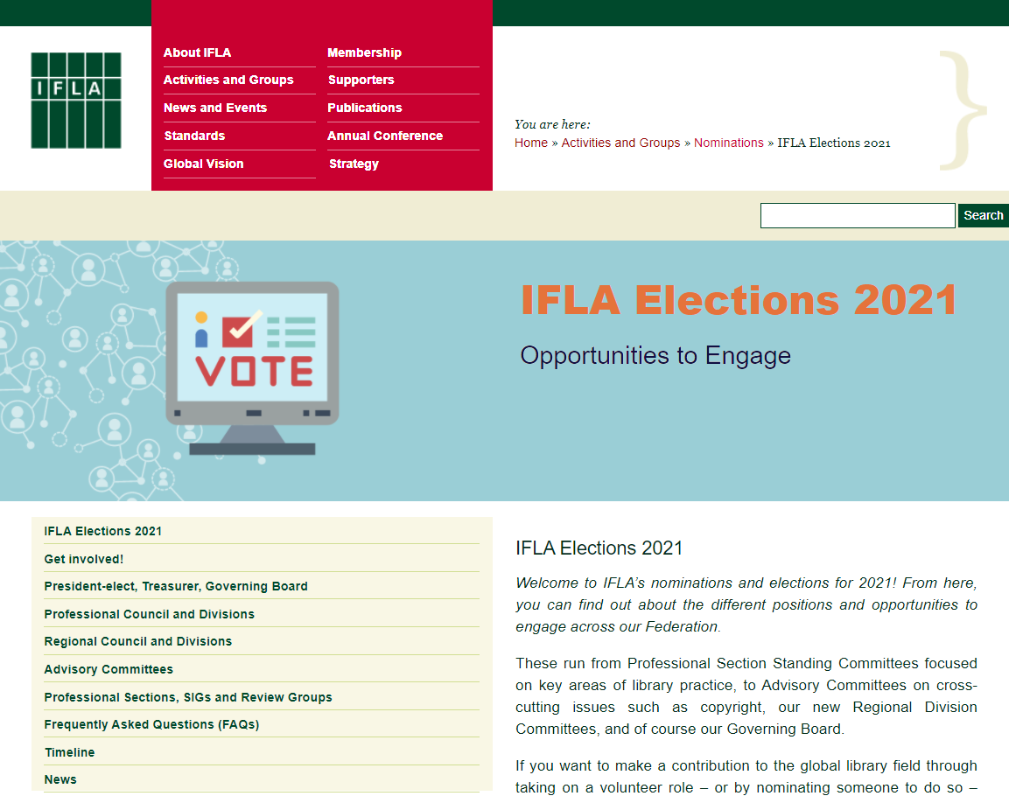
https://www.ifla.org/elections-2021

Slide 22
Nominations Process: Key Considerations
We want this to be the strongest, most diverse range of candidates ever!
Each role requires both a nominee and a nominator*
Nominators should fill in a nominator form (you should have received the link)
Nominees should fill in a nominee consent form (once you know you have enough nominators)
You can make as many nominations as there are places available
Deadline: 13 April, 12pm CEST
* With the exception of Special Interest Group Committee Members, who can self-nominate

Slide 23
Summary: Association Members can nominate for
President-elect, Treasurer, Governing Board Members, Regional Council Chair
Professional Section Standing Committee members (for Sections for which you are registered)
Regional Division Committee members in your region
Advisory Committee Chairs and members*
Review Group members
* Only National and International Association Members

Slide 24
Institution Members can nominate for
President-elect, Treasurer, Governing Board Members, Regional Council Chair
Professional Section Standing Committee members (for Sections for which you are registered)
Regional Division Committee members in your region
Advisory Committee members
Review Group members

Slide 25
Affiliates (Association, Institution and Personal) can nominate for:
President-elect, Treasurer, Governing Board Members, Regional Council Chair
Professional Section Standing Committee members (for Sections for which you are registered)
Regional Division Committee members in your region

Slide 26
Professional Section Standing Committee Chairs and Secretaries can nominate for:
Professional Council Chair
Professional Section Standing Committee members can nominate for:
Professional Division Committee Chairs

Slide 27
Opportunities for Nominees
Build your networks
Gain new experiences and knowledge
Contribute to the advancement of the field
Develop your leadership skills
Bring you enthusiasm, commitment and curiosity!

Slide 28
Don’t forget!
Find your nominators (as many as you need!)
Fill in your nominee consent form
The deadline: 12pm CEST, 13 April 2021

Slide 29
24 May, 12pm CEST: Closing of Elections for President-elect, Treasurer, Governing Board members-at-large, Regional Council Chair, Regional Division Committee members, Section Standing Committee members
31 May, 12pm CEST: Closing of Elections for Professional Council Chair and Professional Division Committee Chairs
26 April: Announcement of Candidates and Opening of Electronic Voting for President-elect, Treasurer, Governing Board members-at-large, Regional Council Chair, Regional Division Committee members, Section Standing Committee members
13 April, 12pm CEST: Nominations Close:
3 May: Announcement of Candidates and Opening of Electronic Voting for Professional Council Chair and Professional Division Committee Chairs
14 June: Publication of Results for Professional Council Chair and Professional Division Committee Chairs
1 June: Publication of Results for President-elect, Treasurer, Governing Board members-at-large, Regional Council Chair, Regional Division Committee members, Professional Section Standing Committee members
June – August: Nominations and publication of candidacies for elections held within Committees
Day following the IFLA General Assembly in August 2021: New Committees take office
Next Steps
#WeAreIFLA

Slide 30
Questions and Answers:
Nominations Process

Slide 31
Questions and Answers:
General Questions

Slide 32
We Are
IFLA
#WeAreIFLA

