Slide 1
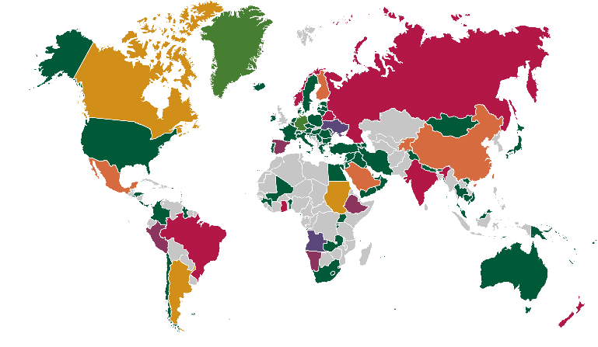
Library Map
of the World
IFLA WEBINAR
Library Map of the World
What’s going on and how to engage?
@IFLA_LibraryMap
#WorldLibraryMap

Slide 2
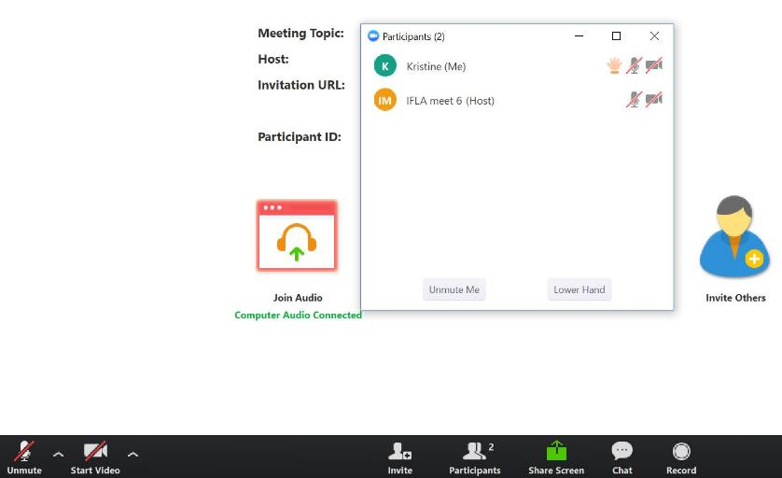
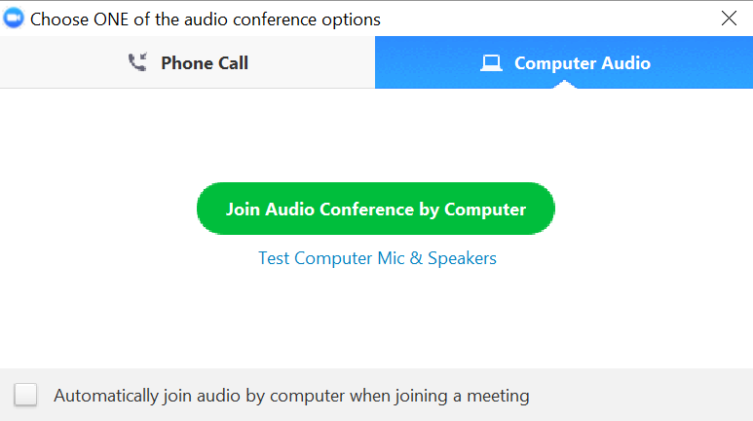
Webinar instructions
When entering the meeting room please make sure to connect to audio, choosing the option you prefer (Phone call or Computer audio):
Once you are in the room, note that you will be muted by default to avoid sound interferences:
X
X
Please be careful NOT to share your screen or video as this could interfere with the webinar
Click on Chat to contact us for support or send your questions to the group

Slide 3
Agenda
Opening
Gerald Leitner, IFLA Secretary General
Meet the Library Map of the World (LMW) Team
Kristine Paberza, Eshka Lake and Vesselina Vassileva
On the agenda — three engagement areas
Data
Country Pages
SDG Stories
Stay tuned with the LMW!
Questions and Answers

Slide 4
Opening
Gerald Leitner
IFLA Secretary General

Slide 5
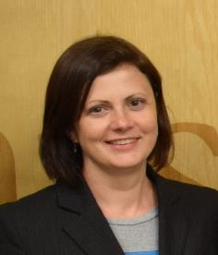
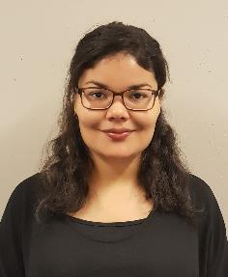
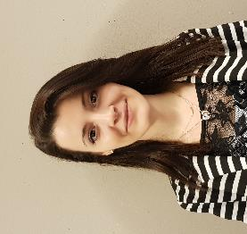
Meet the LMW Team
Kristine Paberza
Member Engagement Officer
Eshka Lake
Administrative Assistant, Data Processing and Analysis
Vesselina Vassileva
Administrative Assistant, Data Processing and Analysis

Slide 6
On the agenda – three engagement areas
DATA
(Library Statistics)
Scope (metrics and library types)
Data partners
Annual cycle
Facilitation and curation process
COUNTRY PAGES
(Library Landscape)
Scope (generated / contributed content)
Content partners
Ongoing facilitated process
Curation process
SDG STORIES
(Library Stories)
Storytelling Manual
Minimum requirements
Contributors (Individual libraries / National partners)
Curation process

Slide 7
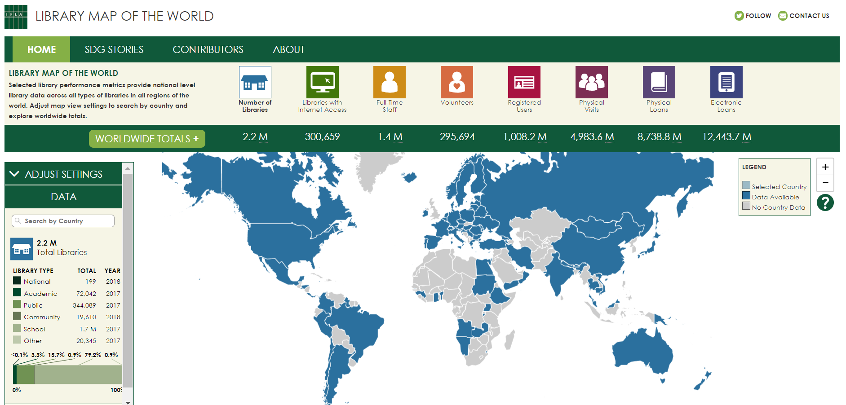
Library Map of the World
DATA

Slide 8
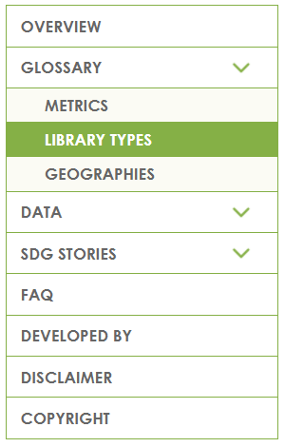
8 metrics for all library types
LIBRARY TYPES
METRICS
National libraries
Academic libraries
Public libraries
Community libraries
School libraries
Other libraries
Number of libraries
Libraries with Internet access
Staff (FTE)
Volunteers (headcount)
Registered Users
Physical Visits
Physical Loans
Electronic Loans

Slide 9
Data collection in partnership
Data collection starts at the individual library
Data aggregation at the national level
Global library statistics
LMW Data partners
collate data at the national level
National library associations
National libraries
Other libraries
Other library support organisations

Slide 10
Ongoing annual cycle
National data collection
Preparation for global data collection
Submission of new or updated data
Interim deadline for WLIC
Submission of new or updated data
Closing of annual data collection
Engagement analysis
Data availability percentage index
Jan Mar Apr Jun July Oct Nov Dec

Slide 11
Submission of new or updated DATA
Start with what you have – existing statistics
Collaborate at the national level and submit aggregated data
Electronic submission form – unique links shared with data partners
Update your data (fill in the form) even if your previously submitted data didn’t change:
Data is not available
Library type/Metric is not applicable

Slide 12
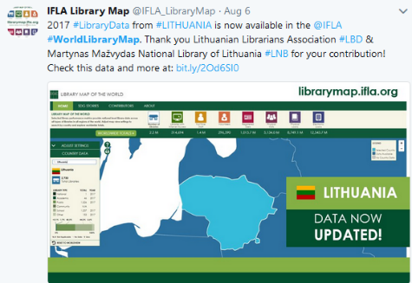
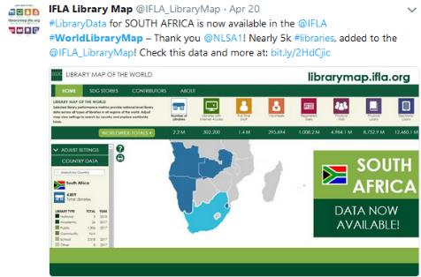
Curation and publishing of your DATA
Quality check by the LMW team
Weekly data updates on the LMW website
On-going messaging on the LMW Twitter: @IFLA_LibraryMap

Slide 13
COUNTRY PAGES
Library Map of the World
THE NEXT BIG STEP
Separate pages for each country with information about:
Libraries and library field
Organisations
Policy and Legislation
Education and Events

Slide 14
Scope of content
GENERATED CONTENT
CONTRIBUTED CONTENT
Facts about the country
Performance metrics
Contextual indicators
SDG stories
Description of library environment
Library location resources
Organisations
Policy and Legislation
Education and Events

Slide 15
Content partners
Co-create
Engage
Inform
LMW Content Partners
Liaise with other institutions / experts in the country
National library associations
National libraries
Other libraries
Other library support organisations

Slide 16
Ongoing process
Ongoing process of engagement, review and update of the content
Invitation to engage, review and update the content
Engagement analysis
Jan Mar Apr Jun July Oct Nov Dec

Slide 17
Preparation and submission of content
Essential precondition – we must have received Data submission before opening the Country Page
Review the submission form (PDF), identify information gaps, gather information from other organisations and/or experts
Submit through an electronic submission form – unique links sent to content partners

Slide 18
Curation and publishing of your content
Curation by the LMW Team
Launching the Country Pages functionality at IFLA WLIC 2018 in Kuala Lumpur
Ongoing messaging on the LMW Twitter: @IFLA_LibraryMap

Slide 19
SDG STORIES
Library Map of the World

Slide 20
A storytelling manual
DOWNLOAD PDF
Inspire
Prepare
Submit
Advocate

Slide 21
Minimum requirements for each story
WHY?
Description of a problem or challenge in the community that your library activity, project or programme was designed to address
WHAT? HOW? WHEN?
Brief description of an activity, project or programme
SO WHAT?
Description of IMPACT on the community and evidence of its contribution to local, regional or national development needs

Slide 22
Curation of your story – three phases
Working on title and narrative
Storytelling Manual – How to tell your story
Checklist
Preparing illustrations (pictures / videos) and further information links
Manual – How to tell your story visually
How to deal with copyright
Checklist
Working on translation to other language
Title and Narrative
Metadata for pictures and videos
Titles of further information links
1
Title and Narrative
2
Illustrations
3
Translation

Slide 23
Engagement scenarios
DATA
(Library Statistics)
COUNTRY PAGES
(Library Landscape)
SDG STORIES
(Library Stories)
Data Partners
Content partners
Individual libraries
National partners
Individual libraries
Data owners
Individual libraries
Content owners
Individual libraries
LMW Contributors

Slide 24
Stay Tuned with the LMW!
Follow us on Twitter: @IFLA_LibraryMap
Use the hashtags #WorldLibraryMap #StoriesThatMatter #Lib4Dev #SDGs
Visit the website: librarymap.ifla.org
Contact us at: librarymap@ifla.org

Slide 25
Questions and Answers
Use the Zoom chat option to send your questions!
Recording and slides will be available in the IFLA website (bit.ly/2NK3zHS)
We will also share answers to the questions that we didn’t have time to answer!

Slide 26
Library Map
of the World
IFLA WEBINAR
Library Map of the World
What’s going on and how to engage?
@IFLA_LibraryMap
#WorldLibraryMap

