Slide 1
Applying Universal Design in American Public Libraries
Renee Grassi, Dakota County Library
Minnesota, U.S.A.

Slide 2
Agenda
Advantages of Universal Design for public libraries
My Library: Dakota County Library
Universal Design in practice
Lessons Learned
Advice for public libraries applying Universal Design

Slide 3
Advantages of Universal Design for public libraries
Fulfills mission of American public libraries
Can be applied to any project or service area by all levels of staff
Supports and celebrates diversity in community
Promotes independent use and participation
Integral part of on-going equity and inclusion work

Slide 4
Dakota County Library
County public library system located Southeast of Minneapolis-Saint Paul, Minnesota, U.S.A.
Population: 420,000 people
Geography: one third rural, suburban, and urban
9 library buildings
11 school districts
Budget: $13.8 million USD
Full-Time Equivalent: 130

Slide 5
Universal Design in practice: Dakota County Library’s American Sign Language Celebration

Slide 6
Program overview
All are Welcome: American Sign Language Celebration
For all ages and abilities
Explore Deaf culture and learn American Sign Language (ASL) through stories, games and crafts
Stories read in ASL by Matt Meinhardt from Metro Deaf School and voice narration and interpretation provided by American Sign Language Interpreting Services

Slide 7
Program content
Resources from Dakota County Library, the Minnesota State Academy for the Deaf and MN Resource Libraries available
Activity stations included button making, craft making, book on display, and light refreshments
Funded by Minnesota Department of Human Services Innovations Grant for Disability Services

Slide 8
Applying Universal Design
Co-created by both hearing and Deaf individuals
Welcomed Deaf, Hard of Hearing, and Hearing to program experience
Re-arranged furniture in library and program room for improved sightlines and open-concept layout
Designed program support documents and in-building signage with text and visuals
Co-created script for promotional video utilizing American Sign Language, captioning, and voiceover

Slide 9
Universal Design for Learning
Activities open to all age groups and abilities
Provided choice in group activities
Program content incorporated multi-sensory learning opportunities
Kinesthetic
Tactile
Visual
Auditory

Slide 10
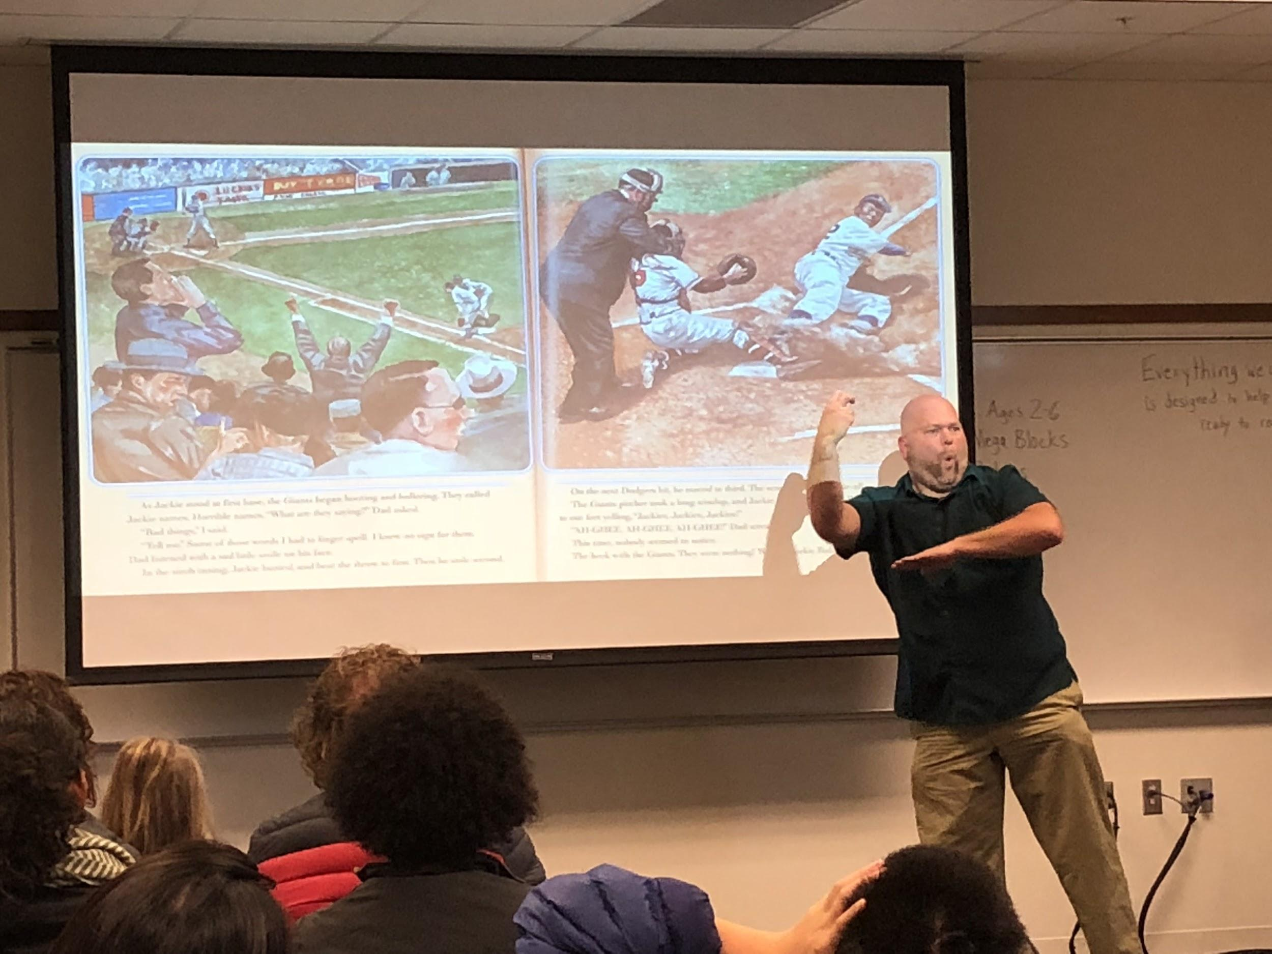
Storytelling in ASL

Slide 11
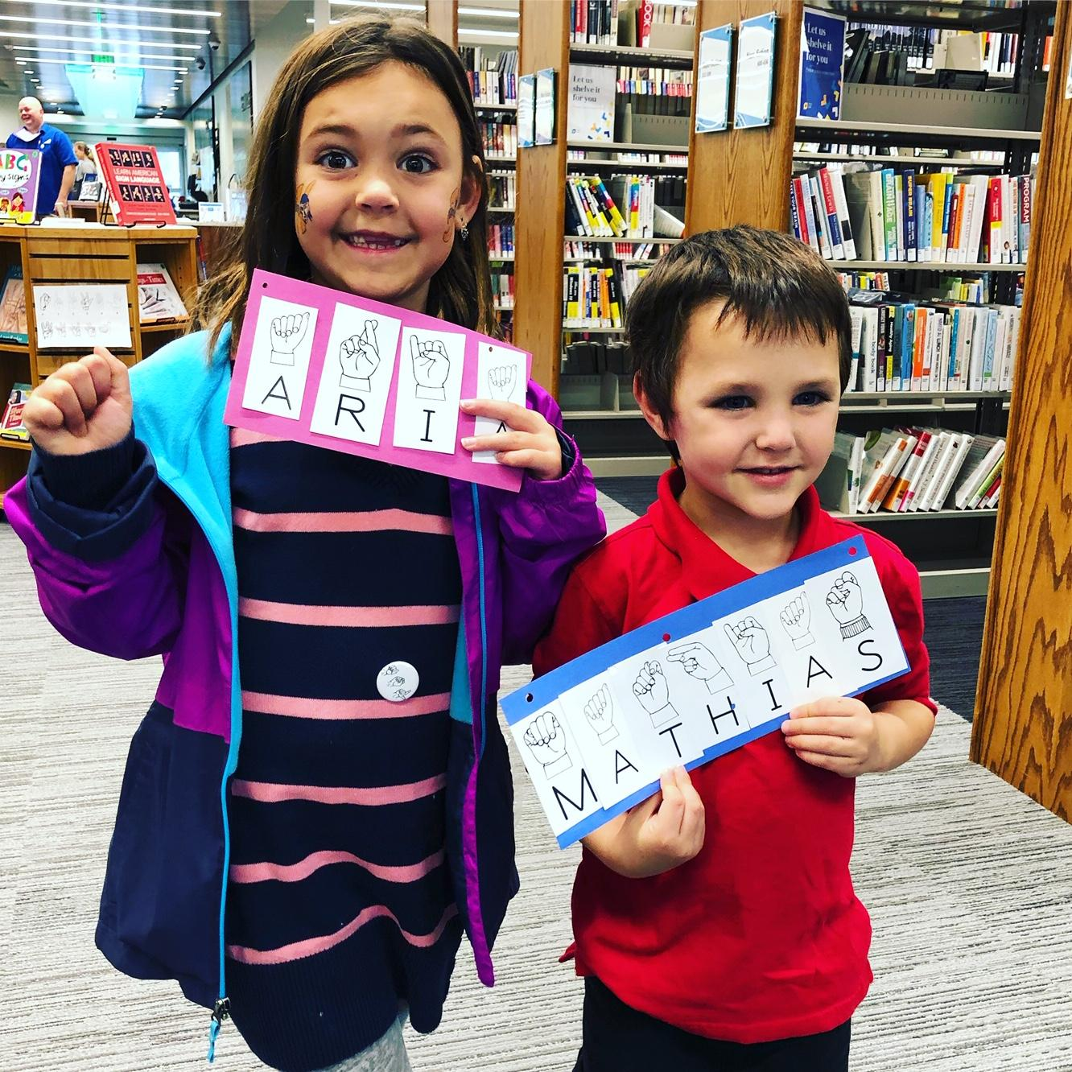
Kids making crafts

Slide 12
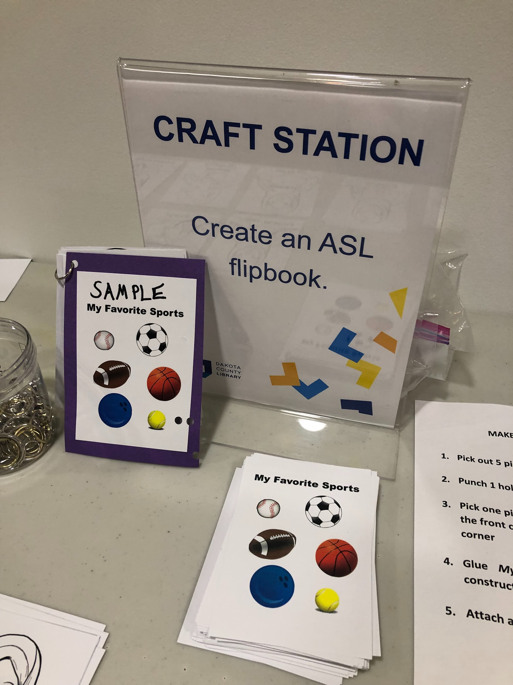
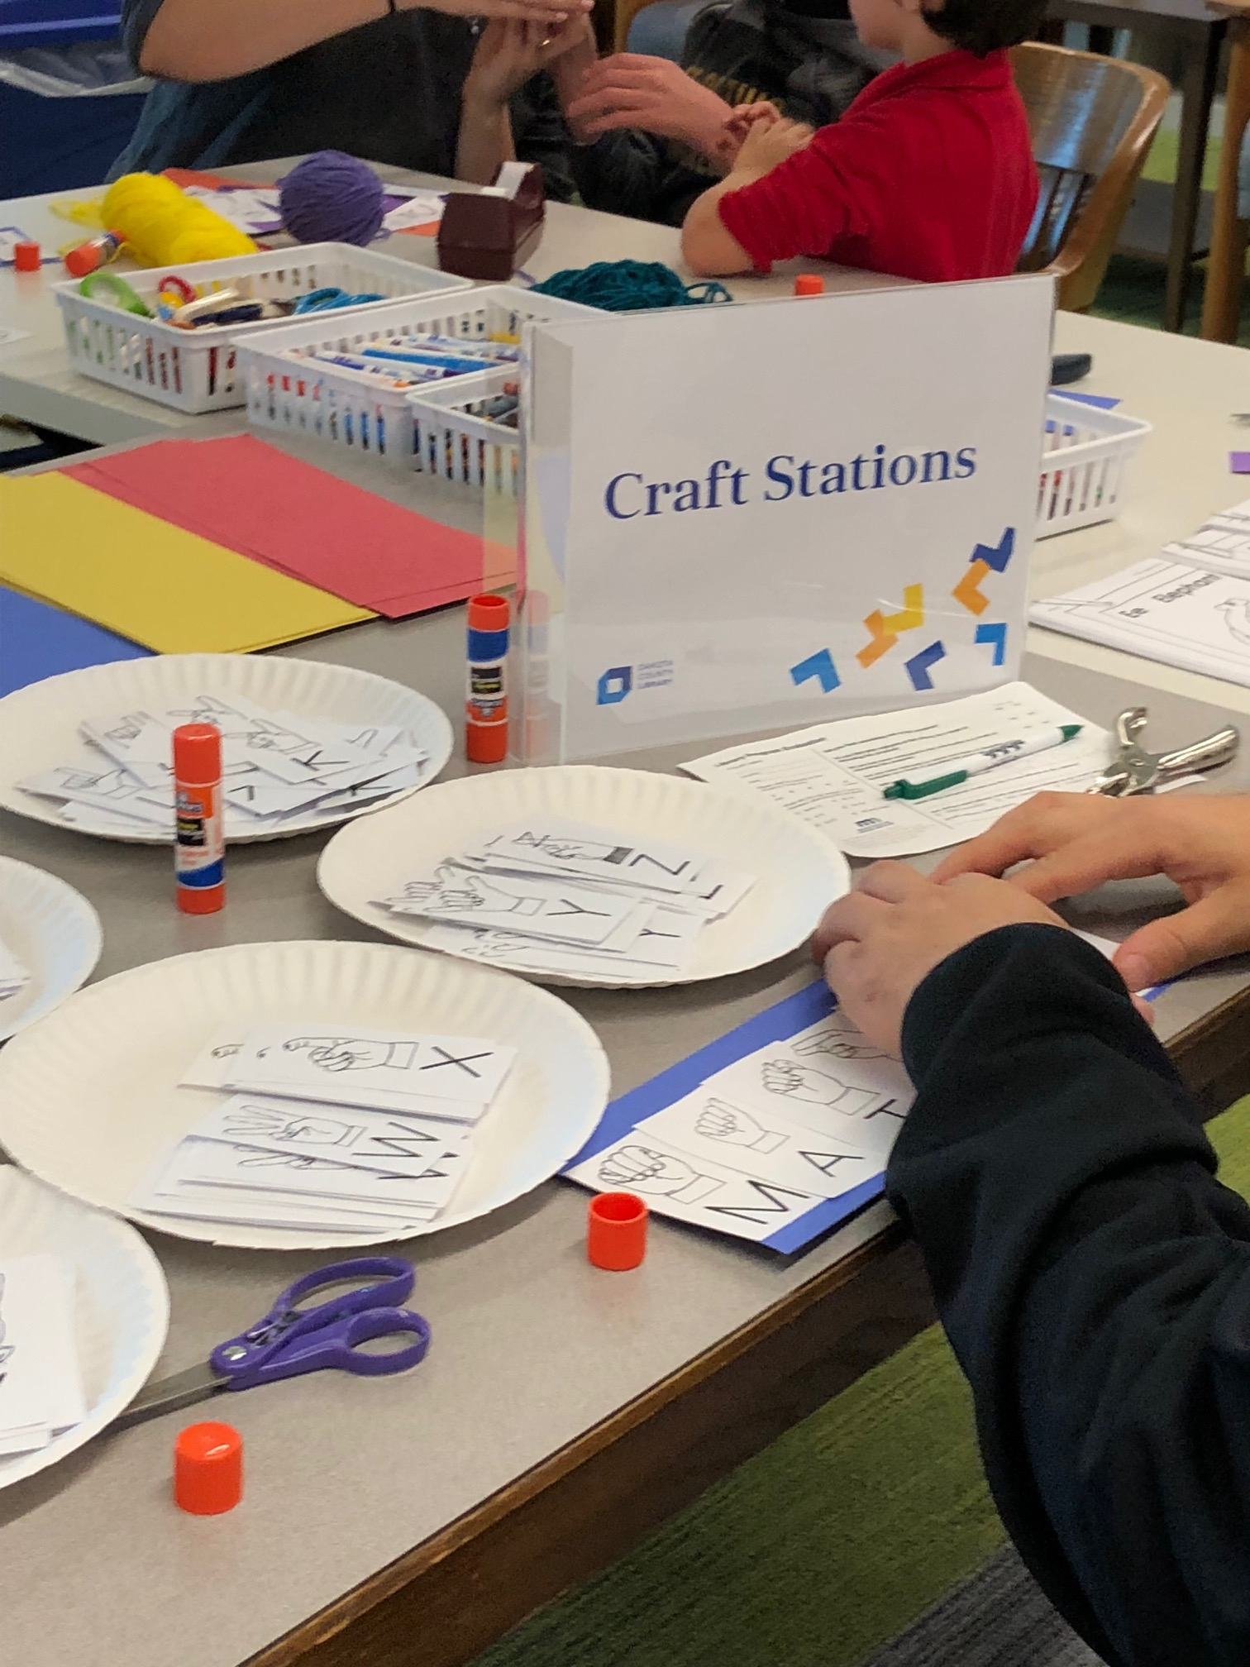
Craft Stations

Slide 13
Lessons learned
Co-create programs whenever possible
Set aside additional time during planning stage
Don’t be afraid to innovate

Slide 14
Advice for public libraries
Learn how other libraries are applying Universal Design to programs and services
Advocate for your colleagues to learn about Universal Design at your organization

Slide 15
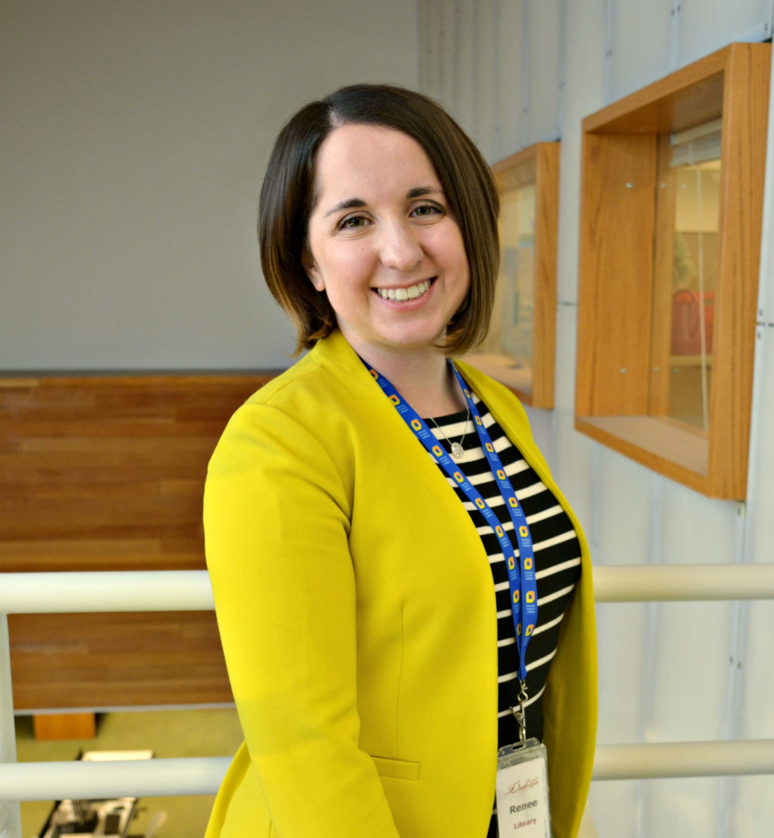
Thank you!
Renee Grassi, Dakota County Library
Visit Renee’s website

